Slide 1
Security Operations
(Foundational Concepts, Investigations, Incident Management, Disaster Recovery)
13%

Slide 2
Test Objectives at a Glance
7.1 Understand and comply with investigations
7.2 Conduct logging and monitoring activities
7.3 Perform Configuration Management (CM) (e.g. provisioning, baselining, automation)
7.4 Apply foundational security operations concepts
7.5 Apply resource protection
7.6 Conduct incident management

Slide 3
Test Objectives at a Glance
7.7 Operate and maintain detective and preventative measures
7.8 Implement and support patch and vulnerability management
7.9 Understand and participate in change management processes
7.10 Implement recovery strategies
7.11 Implement Disaster Recovery (DR) processes
7.12 Test disaster recovery plans (DRP

Slide 4
Test Objectives at a Glance
7.13 Participate in Business Continuity (BC) planning and exercises
7.14 Implement and manage physical security
7.15 Address personnel safety and security concerns

Slide 5
Domain Objectives 7.1
7.1 Understand and comply with investigations
  Evidence collection and handling
  Reporting and documentation
  Investigative techniques
  Digital forensics tools, tactics, and procedures
  Artifacts (e.g. computer, network, mobile device)

Slide 6

Investigations – Role of the First Responder Guidelines
The first responder is the first person who arrives to investigate and respond to any detected activity
This includes, but is not limited to:
  System administrators
  Computer Network Defense Service Provider (CNDSP) technical staff
  Counter Intelligence (CI)
  Law Enforcement (LE)
Notes:
Determine the initial impact of the incident.
Collect as much information about the incident as possible.
Document all findings
Share this collected information with appropriate points of contact to support root cause identification.
First responder procedures and processes must be in place to ensure the consistent and proper initial response to events, incidents, or other suspicious activities.
First responders must have a defined process and procedure in place governing what they can and cannot do at the scene. First responders who will not handle the investigation or analysis must be ready to turn over all their information in a clear, concise manner that is easily understood by others. First responders must be knowledgeable and prepared to be able to collect data and forensic evidence. Along with a standard incident response and reporting plan, they must also have a tested and documented toolkit that can be used for collection (data acquisition) and response in a forensically sound manner.
Policies and Procedures:
Policies and procedures are required to ensure a consistent and proper response to events and incidents. This must include:
Determination of a designated first responder and his or her responsibilities.
Guidance for non-expert or technical personnel who detect an event or incident to ensure they do not make changes to the system and to ensure they report it to the appropriate command authority or CNDSP.
Instructions for creating, using, and maintaining a first responder trusted toolkit.
Infrastructure to create and maintain a trusted test bed to test and document tools before adding them to the toolkit.
A defined collection strategy that outlines what type of information and data will be collected, with what tools, and how it will be stored and documented.
Instructions for performing forensic data acquisition and maintaining a corresponding chain of custody.
Instructions about what type of preliminary response actions the first responder is approved to make related to containment, notification, or documentation actions.
Each C/S/A and field activity, in coordination with their CNDSP, will define first responder policies and procedures for their areas and provide guidance to Tier Three.

Slide 7
Your Security has Been Breached
Be Aware
  A first responder will often respond to a system still under attack
  Be prepared to assess an active attack
  Be prepared to treat the computer system as a crime scene
  Respond already knowing your course of action per the given situation

Slide 8
Reasonable Searches
4th Amendment protects American citizens from unreasonable searches and seizure
Types of searches:
  Consent,
  Plainview (plainview doctrine),
  Search incident to arrest (plainview)
  Protective sweep search (plainview)
  Search warrant
  Writ of possession; take charge of evidence if it is in danger of being destroyed.
  EXIGENT CIRCUMSTANCE=judge decides admissibility if evidence obtained prior to search warrant.
Notes:
Fourth Amendment An amendment to the U.S. Constitution that prohibits government
agents from searching private property without a warrant and probable cause. The courts
have expanded their interpretation of the Fourth Amendment to include protections against
wiretapping and other invasions of privacy. Sybex 9th ed.
Riley v. California dealt with how the Fourth Amendment applies to searches incident to arrest. The traditional rule is that when somebody is arrested, the government can search everything on their person for evidence, with no limitations. The question in Riley was whether that rule applies when the item is a cell phone. And the Supreme Court said there's a different rule for cell phones because of the nature of computer searches: Computer and cell-phone searches are so different, so much information is stored there — and such personal information — that if the government wants to search a cell phone incident to arrest, they need a warrant. And the result is a computer-specific rule: one rule for physical searches, another rule for computer searches. https://www.realclearpolicy.com

Slide 9
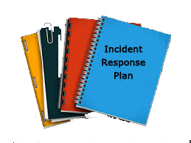
Investigations – Types of Responses to Incidents
Hands Off
  May need to wait for a trained analyst to properly collect evidence
Shutdown
  Determine if shutting down the computer is necessary
Live
  Memory contains evidence that does not survive reboot
Postmortem vs. Live Investigations
  The situation will dictate which method is best to use while causing the least impact
Notes:
Data and information to be gathered for forensics analysis or evidence must be obtained and handled IAW various applicable laws, possibly spanning many jurisdictions, in order to ensure the
authenticity and reliability of the information for forensics analysis as well as to be admissible in a court.
Hands Off:
For incidents to be investigated for computer crime, incident handlers and first responders must understand proper forensics and evidence handling policies and procedures
Data and information to be gathered for forensics analysis or evidence must be obtained and handled IAW various applicable laws, possibly spanning many jurisdictions, in order to ensure the authenticity and reliability of the information for forensics analysis as well as to be admissible in a court
Shutdown:
A system will not be shutdown or disconnected from the network prior to acquiring and preserving the data (e.g., making a system image) unless authorized by CI, LE, or command authority
The exception to this is if the machine begins to perform destructive tasks, such as deleting files or formatting drives, then the computer should be shutdown quickly
As soon as it is determined an incident has occurred, the computer should be kept on and in the same state as when the incident was discovered. Guidance to shutdown, alter settings, saving settings, or any other action will be determined by the incident responder (i.e., analyst and law enforcement)
CJCSM 6510.01A 24 June 2009
Postmortem vs Live Investigations:
Is shutting down the system the most efficient and effective method to gather potential electronic evidence?
Does shutting the system down protect the evidence or destroy it?
Does live analysis destroy evidence by overwriting it?
Is the incident potentially destroying data, attacking another system or potentially destructive?
Containment vs. evidence?
Live:
Sometimes the computer can’t be shut down
Sometimes the hard drive is too big to image
Sometimes physical access is not an option
Encryption could be in use
Volatile content goes away when the power goes away
Access to network environment logs & data
Anti-Forensics
Sometimes, unplugging alerts the bad guys
Open applications can give clues to investigators
Consider this scenario. You have a robbery at a local convenience store. You have two clues to who committed the crime. One is a video from surveillance cameras and the other is muddy footprints the culprit tracked in. The video is like memory, it has details about who the culprit was and what they did. The footprints are like the hard drive. It just has a record of the intrusion but not necessarily what was taken. As law enforcement, wouldn’t you like to have the video?

Slide 10


Types of Evidence
Real (or Physical)
Documentary (Hearsay Rule)
Best
Secondary
Direct
Conclusive
Circumstantial
Corroborative
Opinion
Hearsay
Exculpatory
Notes:
Real: something that may actually be brought into the court; murder weapon, clothing or an other object; computer crime – keyboard, hard drive. Tangible or physical
Documentary: any written items to prove the fact at hand (log printouts).
Best: primary evidence used in trial as it provides the most reliability; e.g. when a signed document is used as evidence, the original must be used. Relevant, authentic, accurate, complete, convincing……. Federal Best Evidence Rule: Exception- if printout accurately depicts content of computer, it is an original
Secondary: copies of the original; not viewed as reliable and strong; oral evidence, such as testimony of a witness, or copies of a signed document.
Direct: oral testimony (lay witness) based on evidence gathered through the witness's five senses; can prove a fact all by itself, does not need backup info to refer to; can be testimony from an eye witness.
Conclusive: irrefutable and cannot be contradicted, stands by itself without corroboration (DNA).
Circumstantial: can prove an intermediate fact that can be then used to deduce or assume the existence of another fact. Inference on other information.
Corroborative: supporting evidence used the help prove an idea or point; cannot stand on its own.
Opinion: a witness testifies only to the facts not their opinion of the facts. An expert witness is the exception when their opinion is what is needed.
Hearsay evidence: Second-hand evidence. Normally not admissible. Based on reports of others rather than personal knowledge of a witness. Most of the time, computer related documents are considered hearsay. When generating and collecting computer logs, it has to be collected as part of normal business activities and not just one time for court or on one individual. Chain of custody will help with ensuring the logs have not been tampered with.
Hearsay has 30 exceptions: electronic and paper business records are hearsay evidence, but if created in normal course of doing business, there is an exception and are admissible if reliability can be proven.
Opinion Rule: pertains to non-expert witnesses.
Exculpatory: exonerates or diminishes defendant liability. Can not be concealed. Called prosecutorial misconduct when suppressed.
Inculpatory: proves guilt
Voirdire: preliminary examination of prospective witnesses, under oath, to determine their competence or suitability
Expert Witness: Preliminary reports are risky, may be open to discovery, may paint different conclusions, can’t destroy them (spoliation)
Federal Courts: as a matter of rule all technical, scientific or expert witnesses submit a report prior to trial in civil cases. Must include fee paid and testimonies given for last 4 years, 10 years of published writings and previous compensation received.
Disposition Bank: stored library of witness testimony; opposing lawyers can go there for samples of previous testimony
Source: Sybex CISSP Study Guide 4th Edition
ISC2 Guide to the CBK

Slide 11

Investigations – General Guidelines
Investigation methodology
  Minimize handling/corruption of original data
  Account for any changes and keep detailed logs of your actions
  Comply with the five rules of evidence
  Do not exceed one’s knowledge
  Follow your local security program policy and obtain written permission
  Capture as accurate an image of the system as possible
  Be prepared to testify
  Ensure your actions are repeatable
  Collect evidence quickly and accurately
  Proceed from volatile to persistent evidence
  Do not run any programs on the affected system
Notes:
Do have written procedures-these protect the forensic team
Additional investigation methodology:
Proceed from volatile to persistent evidence
Act ethically and in good faith
Do not work too fast, making mistakes
Do not exceed one’s skills or abilities
Image the hard drive (2 copies); One copy is a library copy and is archived. The second is for investigator usage.
Mark evidence with a permanent marker.
Hash with MD5 or SHA1: acceptable hashing algorithms for integrity maintenance.
Use Write-blocker: prevents data from being written to suspect drive during imaging (copy) process.
Legal banners strengthen the case against an employee or intruder
July 09: 5-4 supreme court ruling-Melendez-Diaz versus Mass.
may require live testimony by forensic analysts
submitted certificates of forensic reports were in error ad did not allow the defendant to confront witnesses against him
Source: Sybex CISSP Study Guide 4th Edition
ISC2 Guide to the CBK

Slide 12

Investigations - Crime Scene
Digital crime scenes are physical (i.e. server) and virtual (i.e. data on a Storage Area Network (SAN))
Identify the scene
Protect the environment
Identify evidence and potential sources of evidence
Collect evidence
Minimize the degree of contamination
Start the Chain of Custody
Notes:
Chain of Custody: Follows evidence through the evidence lifecycle, from identification-through entire lifecycle; ends with destruction, return to owner, or permanent archiving
chain of evidence The process by which an object is uniquely identified in a court of law. Also known as the chain of custody.
Sybex 8th ed.
Computer Forensics: Computer Forensics deals with the collection of computer related evidence in a legal manner.
Has traditionally been lacking in most organizations is proper evidence handling and management.
Note: There are trained professionals who specialize in computer forensics. This is not something ordinary network administrators should carry out. Let them do the work. If you do not properly handle evidence, it may not hold up in court. Don’t try to be the hero.
If you decide not to call in the experts, you should abide by principles of a sound investigation:
Never conduct an investigation on the actual system that has been compromised.
Image the hard drive and mark evidence with a permanent marker.
Do not hack back to stop the crime.
Document, document, document.
Crime Scene (Criminalistics): The principles of criminalistics apply to both digital and physical crime scenes.
Things to bring: tags, labels, forms, antistatic bags, tools, antistatic bands, tape, evidence bags, cable ties, camera, permanent markers, checklist, software
Chain of Custody: Follows evidence through the evidence lifecycle, from identification-through entire lifecycle; ends with destruction, return to owner, or permanent archiving.
FBI Cybercrime labs have seen 2000% increase since 1996

Slide 13

Investigations - Crime Scene
Understanding the following will help correctly identify the root cause of an incident:
  Locard’s Exchange Principle states that a perpetrator will:
    Leave something behind
    Take something with them (Evidence Dynamics)
      exchange principle
  M.O.M. - Behavior of suspects:
    Motives – who and why
    Opportunity – where and when
    Means – capabilities a criminal would need to be successful
  Modus Operandi (MO) – the way a crime was committed
Notes:
In forensic science, Locard's exchange principle holds that the perpetrator of a crime will bring something into the crime scene and leave with something from it, and that both can be used as forensic evidence.

Slide 14

Investigations – Evidence Collection and Handling
Chain of Custody (COC) refers to the who, what, when, where, and how the evidence was handled from its identification through its entire lifecycle
Notes:
A simple example of a chain of custody form. The chain of custody form accompanies the evidence and provides continuity of possession. Many forms require signature to release and take custody. This form only addresses custody.
chain of custody A document associated with legal evidence that tracks the people in
authoritative control over the evidence between the moment it’s discovered and when it’s presented
in court. Aka chain of evidence.
chain of evidence The process by which an object is uniquely identified in a court of law.
Aka chain of custody.
Sybex 9th ed.

Slide 15
Investigations – Information, Instrumentation and Interviewing
Three components of a criminal investigation:
  Information
    Information accumulation (most important)
  Instrumentation
    Method to gather information
  Interviewing
    Method to gather information
Notes:
Sometimes, unplugging alerts the bad guys
Open applications can give clues to investigators
Memory contains evidence that does not survive reboot

Slide 16
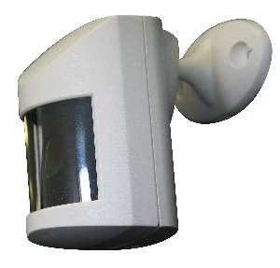
Investigations – Evidence Collection and Processing
Intrusion Detection and Prevention Systems
  Electrical Circuit
  Light Beam
  Different Types of Energy Fields
    Passive Infrared Sensors (PIR or PID)
      Measures light energy level
      Detects heat and movement
    Microwave and Ultrasonic Systems (invisible)
    Electro-static
  Sounds and Vibration
  Motion
  Coaxial Strain-Sensitive Cable
  Time Domain Reflectometry (TDR) Systems
  Balanced Magnetic Switch (BMS)
Notes:
Electrical Circuit: uses foil or wire contacts places across door or window frames, carrying a low level of current. (door and windows)
Light Beam: photoelectric cell receives a small light source across the secure boundary. When the path of light to the cell is interrupted, the alarm is triggered. (gate and door way) dust and small material may trigger alarm.
Different Types of Fields:
Passive Infrared Detector (PID): measures light energy within a physical range. When the energy level is changed by the presence of an intruder, the alarm is triggered. Effective in detecting heat and movement but need careful calibration in order to minimize false alarms (heat)
Microwave and Ultrasonic Systems: Transceivers and control units. Transceiver units produce and monitor either a measurement of distance (microwave) or an acoustic energy patter (ultrasonic) across the room and trigger an alarm when this changes. Ultrasonic = invisible but prone to false alarms if significant external sounds impact the acoustic pattern.
Electro-static: capable of converting position and direction of movement into electrical signals based on slight changes in the electrostatic capacitance when lightly touched.
Sounds and Vibration
Acoustical detection system: microphones on floors, walls, ceilings detecting any sound (audio)
Vibration sensors: detect vibration
Secondary verification: trip two sensors before alarm sounds; prevents false alarms
Wave pattern: like sonar; low ultrasonic; high microwave; looks for pattern
Capacitance: electric field; charge around an object or its magnetic field
Coaxial strain-sensitive cable: coaxial cable is woven into the fabric of the fence. The cable transmits an electric field. The cable moves due to strain on fence fabric caused by climbing or cutting. Changes in the electric field are detected within the cable and an alarm sounds
Time Domain Refectometry (TDR) systems: send induced RF signals down a cable attached to the fence fabric. Intruders climbing or flexing a fence create a signal path flaw with can be converted into an alarm signal
Balanced Magnetic Switch: operates similar to electric circuit but uses magnets.

Slide 17
Investigations - Digital Forensic Science
Encompasses all domains in which the evidence or potential evidence exists in a digital or electronic form whether in storage or on the wire and includes:
  Computer Forensics
  Digital Forensics
  Network Forensics
  Electronic Data Discovery
  Cyber Forensics
  Forensic Computing
The Digital Forensic Science Research Workshop defines it as:
  The use of scientifically derived and proven methods toward the preservation, collection, validation, identification, analysis, interpretation, documentation and presentation of digital evidence derived from digital sources for the purpose of facilitating or furthering the reconstruction of events found to be criminal, or helping to anticipate unauthorized actions shown to be disruptive to planned operations
Notes:
forensics The collection, protection, and analysis of evidence from a crime to present the
facts of the incident in court.
preservation In relation to forensics, the preventing of any change from occurring as
related to collected evidence.
Sybex 9th ed.
A generic guideline includes:
Identifying evidence – correctly identifying the crime scene/evidence and potential containers of evidence
Collecting/Acquiring evidence – ensuring that the contamination and the destruction of the scene are kept to a minimum
Examining/Analyzing evidence – using sound scientific methods to determine the characteristics of the evidence, conducting comparison for individual evidence and conducting evidence reconstruction
Presentation of findings – interpreting the output from the examination/analysis based on findings of fact & articulating these in format appropriate for the intended audience (i.e. memo, court appearance, report)

Slide 18
Forensics in the Cloud
Cloud computing can make forensic activities difficult
  Virtualization
    Tracking a virtual machine to a physical device or storage location can be difficult
  Access
    Lack of ownership and lack of control
  Jurisdiction
    Data centers can be located across state or international borders
  Tools/Techniques
    Technology and ownership restrictions can hinder the use of common forensic tools.

Slide 19

Investigations – General Guidelines
International Organization on Computer Evidence (IOCE) devised guidelines for computer forensics and digital/electronic evidence:
    All of the general forensic and procedural principles must be applied
    Actions taken should not change evidence
    Person investigating should be trained for the purpose
    All activity must be fully documented, preserved and available for review
    An individual is responsible for all actions taken with respect to digital evidence
    Any agency, which is responsible for seizing, accessing, storing or transferring digital evidence is responsible for compliance with these principles
Notes:
International Organization of Computer Evidence (IOCE): Created to develop international principles dealing with how digital evidence is to be collected and handled.
Memo from lawyer authorizing investigation Request key words of interest
Begin investigation Make two bit stream images
Compare hashes Extract all data from allocated and unallocated space
Keyword search on allocated and unallocated space Use proper tools to view binary files, etc
Check slack and free space Consolidate and organize findings for paralegal or attorney
5 basic steps:
Identify the Evidence: a digital crime scene is similar to a physical crime scene; identify evidence to include trash bins, documentation, phone records, storage media, and active programs.
Preserve the Environment: avoid contamination and loss of evidence. Control the crime scene: Document. USE WRITE BLOCKERS
Collect Evidence: use approved software, proper methods, proper hardware, legal filter, hidden data searches, establish chain of custody and proper seizure, logging and transportation of evidence.
Evidence Tiers:
(1) volatile- processes, logged on, connections
(2) volatile-scheduled tasks, clipboard
(3) nonvolatile-registry settings, audit policy (4) nonvolatile- event logs, web history
Examine: conduct comparisons, event reconstruction
Analysis: statistics, data mining, timelines, recover lost files, file carving
Present Evidence: document findings/analysis in report and for court
Decision: Ensuring physical and digital property is returned to proper owner; close out the investigation and preserve knowledge gained
4 types of data: allocated space, unallocated space, slack space, bad blocks/clusters, sectors
ACP: attorney client privilege (all findings are confidential)
Digital Forensic Science: study of computer technology and how it relates to the law
Cops or no cops: company loses control of investigation once LE called in, secrecy is not promised, effects on reputation, evidence collected (gone for longtime)
EFS/BITLOCKED: volumes may have to be imaged before shutting down

Slide 20
Types of Laws
Criminal Law
Civil Law (Tort)
Constitutional Law
Administrative Law
International Law
Religious Law
Cultural Law
Tribal Law
Notes:
criminal law Body of laws that the police and other law enforcement agencies enforce.
Criminal law contains prohibitions against acts such as murder, assault, robbery, arson, theft,
and similar offenses.
civil laws Laws that form the bulk of the body of laws in the United States. They are
designed to provide for an orderly society and govern matters that are not crimes but that
require an impartial arbiter to settle disputes between individuals and organizations.
Fourth Amendment An amendment to the U.S. Constitution that prohibits government
agents from searching private property without a warrant and probable cause. The courts
have expanded their interpretation of the Fourth Amendment to include protections against
wiretapping and other invasions of privacy.
administrative law Regulations that cover a range of topics, from procedures to be used
within a federal agency to immigration policies, that will be used to enforce the laws passed
by Congress. Administrative law is published in the Code of Federal Regulations (CFR).

Slide 21

Investigations – Understanding Forensic Procedures
Five (5) Rules of Digital Evidence:
  Authentic
  Accurate (Reliable)
  Complete
  Convincing (Believable)
  Admissible (Fragile)
    Must meet 3 Requirements to be Admissible:
      Relevant
      Material
      Competent
Notes:
5 Rules of Digital Evidence:
Authentic: To be admitted, evidence must be authentic (not a copy or summary) and relevant.
Accurate (Reliable): Your evidence collection and analysis procedures must not cast doubt on the evidence’s authenticity and veracity.
Complete: Truth, whole truth, etc. Exculpatory evidence may not be hidden, must be turned over in response to discovery, etc.
Convincing (Believable): The evidence you present should be clear, easy to understand and believable by a jury.
Admissible (Fragile): If you lose admissibility, you cannot get it back.
Must meet 3 Requirements to be Admissible:
Relevant: to determining a fact related to the crime; nonprejudicial;
Material: must be related to the case
Competent: must have been obtained legally. Evidence obtained illegally would be inadmissible.
You want evidence to be: sufficient(not easily doubted), reliable(competent), relevant(reasonable and sensible)
Probative Value: relate to something in the case; prove something worthwhile
Motion in Limine: motion by lawyer to get hearing to determine if evidence is admissible before the trial.
All relevant evidence is admissible unless some rule says it isn’t (exclusions reverse rules)(exceptions defeat exclusions)
Evidence must pass the hearsay rule (based on 1st hand knowledge), follow a chain of custody, not be excluded for violation or technicality
Evidence must be relevant, have probative value, meet the rules, have no exclusions unless there is an exception, be acceptable to the judge

Slide 22
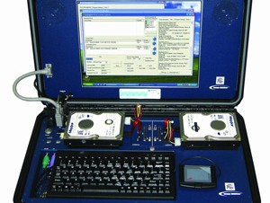
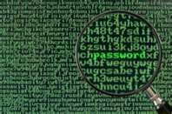
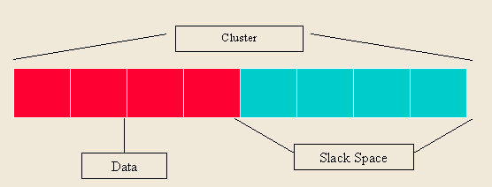
Artifacts
Digital/Electronic evidence is very fragile
  Collect very quickly and in order of volatility
Media Analysis
  Involves the recovery of information/evidence from information media such as hard drives, DVDs, CD-ROMs or portable memory devices.
Network Analysis
  Analysis and examination of data from network logs and network activity for use as potential evidence
Software Analysis
  Analysis/examination of program code
Hardware/Embedded Device Analysis
  Analysis of mobile devices
Notes:
artifacts Any items of evidence left behind by a suspect when performing a criminal or otherwise
violating activity. Syb3ex 9th ed.
Do all collection before any examinations or analysis Establish liaison with law enforcement
Decide when to call in law enforcement Create reporting process
Plan and conduct investigations Senior management
HR Proper collection techniques
Collection issues: FAT32-4gb file size limit may have to segment, don’t compress so you can recover if corrupted.
Digital/Electronic evidence:
May have a short “life span”
Document, Document, Document
Evidence integrity
Hash (MD5/SHA-1)
Digital Signature
Media Analysis:
Allocated space
Area of disk actively containing data
Unallocated space
Portion of disk that does not contain active data (deleted files, etc.)
Slack space
Data stored in leftover cluster space
Bad blocks/clusters/sectors
May have been intentionally marked as bad by attacker
Network Analysis:
Study of data in motion
Recovering data from network equipment and reconstructing the original transaction, conversation, transfer, etc.
Packet payload often finds its way to the hard disk but the virtual envelope that it traveled in is only recorded by network devices it traversed
Software Analysis:
Hardware/Embedded Device Analysis:
E-Discovery: (Dec 1, 2006 amendment to federal rules of civil procedures) opposing parties must discuss e-discovery within 99 days of filing. E-discovery must be filed with the court (e-discovery plan) within 120 days of filing.
Litigation hold: as soon as you are suspected of being a party in a suit, all purging of electronically stored information (ESI) must stop. Audit trails to prove the protections of ESI may be required.
Discovery rules are designed to eliminate surprise.
E-discovery is used like a weapon. Companies will settle to avoid costs of e-discovery if suits target dollar amounts lower than court costs.
Source: Sybex CISSP Study Guide 4th Edition
ISC2 Guide to the CBK
Slack space is a form of internal fragmentation, i.e. wasted space, on a hard disk. When a file is written to disk it's stored at the “beginning” of the cluster. A cluster is defined as a collection of logically contiguous sectors and the smallest amount of disk space that can be allocated to hold a file.
Slack space is an important form of evidence in the field of forensic investigation. Often, slack space can contain relevant information about a suspect that a prosecutor can use in a trial. For example, if a user deleted files that filled an entire hard drive cluster, and then saved new files that only filled half of the cluster, the latter half would not necessarily be empty. It may include leftover information from the deleted files. This information could be extracted by forensic investigators using special computer forensic tools.

Slide 23
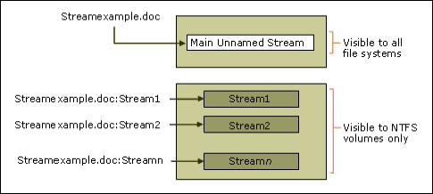
Artifacts– Alternate Data Streams (ADS)
NTFS allows files to be associated with more than one data stream
One file can be a link to multiple Alternate Data Streams of files of any size
Difficult to detect: Doesn’t show up when you run c:\dir
Notes:
What are Alternate Data Streams?
Alternate Data Streams (ADS) are a file attribute only found on the NTFS file system. In this system a file is built up from a couple of attributes, one of them is $Data, aka the data attribute. Looking at the regular data stream of a text file there is no mystery. It simply contains the text inside the text file. But that is only the primary data stream.
This one is sometimes referred to as the unnamed data stream since the name string of this attribute is empty ( “” ) . So any data stream that has a name is considered alternate.
These data streams suffer from a bad reputation since they have been used and abused to write hidden data. Varying from data about where a file came from to complete malware files (e.g. Backdoor.Rustock.A)
If you are up for an experiment, we can easily create and read an alternate data stream. https://blog.malwarebytes.com/101/2015/07/introduction-to-alternate-data-streams/
Graphics:
By removing all but the last 2 bits of each color component in a graphic, an almost completely black image results. Making the resulting image 85 times brighter, results in a different image.
Sound files:
Old Way: Playing a record backwards on a record player would reveal a hidden message.
New Way: In an MP3 steganographic file system, one can insert a USB key and listen to music while stealing and collecting info from the company.
Alternate data streams (ADS):
Allows files to be associated with more than one data stream. One file can be a link to multiple Alternate Data Streams of files of any size.
(NTFS) New Technology File System allows for Alternate Data Streams
Difficult to detect: Doesn’t show up when you run c:\dir
C:\notepad mike.txt:mikehidden.txt
This allows mikehidden.txt to be a hidden ADS
C:\dir
02/26/2004 02:29p 0 mike.txt
Notice – no indication of mikehidden.txt
Although a message was saved in the mikehidden.txt, the mike.txt shows 0 bytes!
Sources:
(ISC)2 CBK 2008 (pgs. 235-236)
Shon Harris CISSP All-in-One Exam Guide 4th Edition (pgs. 674)

Slide 24
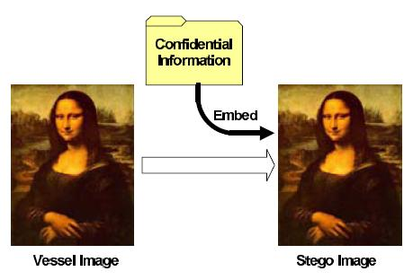
Artifacts– Steganography and Watermarks
Derived from the Greek steganos (hidden or covered)
Buries a message by taking the least significant bit of every byte to carry the secret message
Hides a message within another medium:
  Graphics, Sound files, etc.
Watermarks
  Prove ownership
Notes:
steganography The act of embedding messages within another message, commonly used
within an image or a WAV file. Sybex 8th ed.
Names of popular steganography software: xiao steganography, image steganography, steghide, crypture, SteganographX Plus
Graphics
By removing all but the last 2 bits of each color component in a graphic, an almost completely black image results. Making the resulting image 85 times brighter, results in a different image.
Sound files
Old Way: Playing a record backwards on a record player would reveal a hidden message.
New Way: In an MP3 steganographic file system, one can insert a USB key and listen to music while stealing and collecting info from the company.
Alternate data streams (ADS)
Allows files to be associated with more than one data stream. One file can be a link to multiple Alternate Data Streams of files of any size.
(NTFS) New Technology File System allows for Alternate Data Streams
Difficult to detect: Doesn’t show up when you run c:\dir
C:\notepad mike.txt:mikehidden.txt
This allows mikehidden.txt to be a hidden ADS
C:\dir
02/26/2004 02:29p 0 mike.txt
Notice – no indication of mikehidden.txt
Although a message was saved in the mikehidden.txt, the mike.txt shows 0 bytes!
Sources:
(ISC)2 CBK 2008 (pgs. 235-236)
Shon Harris CISSP All-in-One Exam Guide 4th Edition (pgs. 674)

Slide 25
Domain Objectives 7.2
7.2 Conduct logging and monitoring activities
  Intrusion detection and prevention
  Security Information and Event Management (SIEM)
  Continuous monitoring
  Egress monitoring
  Log management
  Threat intelligence (e.g. threat feeds, threat hunting)
  User and Entity Behavior Analytics (UEBA)

Slide 26

Disasters or Disruptive Events
Three Common Categories
  Natural
    Natural Disasters (Natural)
  Human
    Error and Omissions (Human)
    Warfare, Terrorism, and Sabotage (Human)
    Financially Motivated (Human)
    Strikes (Human)
  Environmental
    Temperature and Humidity Failures (Environment)
    Pandemics and disease (Environment)
  Electrical (All types)
  Personnel Shortages (All types)
  Communication Failures (All types)
Notes:
disaster An event that brings great damage, loss, or destruction to a system or environment.
natural disaster A disaster that is not caused by humans, such as earthquakes, mudslides,
sinkholes, fires, floods, hurricanes, tornadoes, falling rocks, snow, rainfall, ice, humidity, heat,
extreme cold, and so on.
human-made
disasters Disasters caused by humans, including explosions, electrical fires,
terrorist acts, power outages, utility failures, hardware/software failures, labor difficulties,
theft, and vandalism.
Sybex 9th ed.
Errors & omissions: considered the most common source of disruption Caused by humans working within an organization.
Separation of duties is a common method of lessening the likelihood of this type of disruption.

Slide 27

Vulnerability Testing
Evaluating a system or network against a predefined list of vulnerabilities
  System misconfiguration
  Outdated software
  Missing patches
Popular testing tools:
  Nessus
  OpenVAS
  Retina
  SATAN/SAINT
Notes:
Metasploit A vulnerability scanning and penetration testing tool used to exploit flaws in
applications, computers, and networking systems.
sqlmap An open-source database vulnerability scanner.
unauthenticated scan A form of vulnerability scan that tests the target systems without
having passwords or other special information that would grant the scanner special privileges.
This allows the scan to run from the perspective of an attacker but also limits the
ability of the scanner to fully evaluate possible vulnerabilities.
vulnerability A weakness. It can be due to the existence of a flaw, loophole, oversight,
error, limitation, frailty, or susceptibility in the IT infrastructure or any other aspect of an
organization. It can also be the result of the absence of a safeguard or countermeasure or a
weakness in a protection measure.
vulnerability analysis A process used to identify vulnerabilities, or weaknesses. It can
include both technical means, such as vulnerability scans, and nontechnical means, such as
an evaluation or inspection of existing data on threats and vulnerabilities.
vulnerability management A program used to detect weaknesses within an organization.
Vulnerability scans and vulnerability assessments are two common elements of a vulnerability
management program. Vulnerability scans are technical scans performed regularly, and
vulnerability assessments are normally combined with a risk assessment.
vulnerability scan A test performed on a system to find weaknesses in the security infrastructure.
Vulnerability scans automatically probe systems, applications, and networks
looking for weaknesses that may be exploited by an attacker. The scanning tools used in
these tests provide quick point-and-click tests that perform otherwise tedious tasks without
requiring manual intervention.
vulnerability scanners A software tool used to test systems and networks for known
security issues, such as unpatched systems. Both attackers and security administrators use
vulnerability scanners.
Sybex 8th ed.
Security Audits
A test against a published standard
Example: Payment Card Industry Data Security Standard (PCIDSS)
Created by payment card industry security standards council and Adopted by some states as a model for their state security requirements
Has core principles
Build and maintain a secure network
Protect card holder data
Maintain a vulnerability management program
Implement strong access control measures
Regularly monitor and test network
Maintain information security policy
Security Assessment
Big picture view of access control effectiveness
Broad Scope
Areas included in assessments:
Policies, procedures, admin controls
Change management
Architecture
Penetration tests
Vulnerability assessments
Security audits

Slide 28

Penetration Testing
Primary goal is to simulate an attack to evaluate the risk characteristics of an environment
Secondary goal is to test the organizational incident response
Can be employed against anything; usually focus is Internet system and services
Notes:
penetration test, penetration testing A form of customized vulnerability scan that is
performed by a special team of trained authorized entity security specialists rather than by
an internal security administrator using an automated tool. Penetration tests can take many
forms, including hacking in from the outside, simulating a disgruntled employee, social-engineering
attacks, physical attacks, and remote connectivity and virtual private network
(VPN) attacks. Aka ethical hacking and pentest. Penetration testing should be performed
only with the consent and knowledge of the management staff. Sybex 9th ed.
To be successful, set clearly defined objectives, scope, stated goals, agreed-upon limitations, and acceptable activities
Helps you identify:
Vulnerabilities of the system
Gaps in security measures
IDS and intrusion response capability
Whether anyone is monitoring audit logs
How suspicious activity is reported
Suggested countermeasures
Pen testers must:
Always protect client data and system integrity
Maintain the confidentiality of all sensitive client data - there is no legal right to access confidential data (use dummy files)
End the penetration test and escalate the issue, if during the test, past or current malicious activity is identified
Scope and permission for testing should be obtained in writing prior to testing.
Do not fix or repair the system, you are only authorized to test it.
Protect the penetration testing results as it identifies possible information on breaching client security
Prepare for ethical questions on exam addressing the role of the pen tester

Slide 29
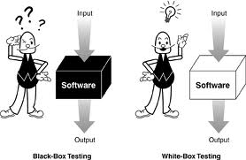
Penetration Testing Strategies
External Testing
Internal Testing
Blind Testing
Double Blind Testing
Targeted Testing
3 basic categories of penetration test:
  Zero knowledge (AKA black box or closed)
  Partial Knowledge
  Full Knowledge (white/crystal box)
Notes:
Penetration Testing Strategies:
External testing: attacks against the network perimeter using procedures performed from outside the organization’s systems . Attack the externally visible servers or devices
Internal testing: performed from within the organization’s technology environment. Gives information on what could happen if the perimeter is penetrated or what an insider could do
Blind testing: using publicly available information about target and conduct its penetration tests. Can be more time consuming and expensive that other types
Double-blind testing: more real life as the organization’s IT staff are not notified of the testing activities
Targeted testing: (lights on) Both the IT department and the penetration team are made aware of the target and network design. Takes less time, more cost effective and efficient
Penetration Testing Categories:
Zero knowledge: Sometimes “call black box or closed” The tester has no knowledge of network/system resources. AKA: blind (DOES NOT REFLECT INSIDER ATTACKS)
Team does not have any knowledge of the target(blind)
Test to see what can be discovered
unknown environment A device of unknown composition whose internal circuits,
makeup, and processing functions are unknown but whose outputs in response to various
kinds of inputs can be observed and analyzed. Unknown environment penetration testing
proceeds without using any knowledge of how an organization is structured, what kinds of
hardware and software it uses, or its security policies, processes, and procedures.Partial Knowledge: The company is providing some information to the tester. Sybex 9th ed.
Team has some high level public or near public information about the target
Test used to control the scope
partially known environment A form of penetration testing that combines the black-box/
unknown environment and white-box/
known environment techniques and is a popular
approach to software validation. Testers approach the software from a user perspective, analyzing
inputs and outputs. Previously known as gray box. Sybex 9th ed.
Full Knowledge: Total knowledge of the network / system. Greater focus on what can be done, as opposed to what can be discovered. AKA : White or Crystal Box; (FAR MORE EFFICIENT)
Team has intimate knowledge of the target
Test to see what can be done
More efficient and safer to conduct

Slide 30
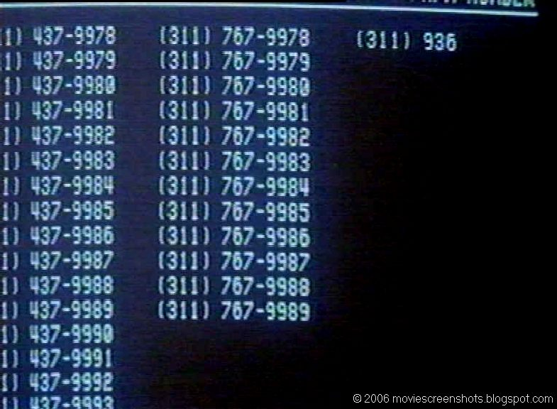
Penetration Testing – Types of Testing
Application testing
Denial-of-service testing
War dialing
Wireless network testing
Social Engineering
PBX and IP phone testing
Notes:
Application Security testing: used to evaluate the controls within an application and its information process flow. Application can be a backdoor into our networks. They sometime are allowed to bypass firewall and IDS.CIA must be incorporated in all application development
Denial of Service testing: evaluate a system’s susceptibility to attacks that will render it inoperable
War dialing: calling a rang of numbers to identify modems, remote access devices, and maintenance connections
Wireless network testing: (war driving) Goal of wireless testing is to identify security gaps of flaws in the design, implementation, or operation of the organization wireless networks
War driving: identifying available access points
Social engineering: often used in conjunction with blind and double blind testing. Test the less technical, but equally important components Human factor of gathering information. (USES THE HUMAN MIND TO BYPASS CONTROLS)
PBX and IP telephony testing: testing the voice mail system and the seizing of long distance trunks. Represents a potential to access into our networks; Hackers can gain access to voice-mail to gather information and monitor activity
IP telephony (VOIP): combination of networking and phone system create a problematic environment. Voice–over-IP Integrated into our directly network so it needs to be tested regularly to see what vulnerabilities are present

Slide 31
Penetration Test Methodology
Reconnaissance/Discovery
  Identify and document information about the target
Enumeration
  Gain more information with intrusive methods
Vulnerability Analysis
  Map the target environment profile to known vulnerabilities
Execution
  Attempt to gain user and privileged access
Document Findings
  Document the results of the test
Notes:
Basic steps:
Planning
Recon
Scanning (enumeration)
Vulnerability assessment
Exploitation
Reporting
Reconnaissance/Discovery – searching for any available information on the target to assist in planning or executing the test (i.e. ping sweeps, checking Internet news groups, dumpster diving, theft, etc.)
Enumeration – aka network vulnerability discover; the process of sending network probes or otherwise communicating with target systems and network devices in order to gain more information (i.e. port scanning)
Vulnerability Analysis – analyze collected data to determine potential vulnerabilities to exploit (i.e. search the Internet to seek options for exploitation)
Execution – executing some form of attack scenario (i.e. exploiting systems and applications)
Document Findings – collect, analyze and document findings so that the information may be used to improve the overall security profile of the environment

Slide 32
Investigations – Evidence Collection and Processing
Security Event Management (SEM) / Security Incident and Event Management (SIEM) aggregates log information
  Store raw information from various system logs
  Aggregate the information in a single repository
Web Servers | e-mail Servers | DB Servers | DNS servers | IDS Servers | VPN servers | Firewall Servers | Routers
Thousands of events per second
Aggregate logs from dozens up to hundred of sources
Correlate events
Apply rule-set and filters
Reporting and visualization engine
Human Reviewer
Dozens of events /day
Notes:
security information and event management (SIEM) A centralized application to automate
the monitoring of network systems across an enterprise network.
log collectors Services that record logs, perform aggregation, or implement centralized logging,
such as security information and event management (SIEM) and syslog.
Sybex 9th ed.
Uses three main languages to facilitate information being processed: Structured Threat Information eXpression (STIX), Cyber Observable Expression (CybOX), and Trusted Automated eXchange of Indicator Information (TAXII)

Slide 33
Investigations – Continuous and Egress Monitoring
Continuous Monitoring as a Service (CMaaS)
  Driven by a focus on Cyber Defense
  Supported by the Continuous Diagnostics and Mitigation (CDM) Program
    Provides specialized IT tools and CMaaS to combat cyber threats in the civilian “.gov” networks
  Cloud service providers exist to support an enterprise architecture
Egress Monitoring
  Is the monitoring and potentially restricting the flow of information that is outbound
  Egress filtering ensures that unauthorized or malicious traffic does not leave the network
Notes:
egress monitoring The process of monitoring outgoing traffic to detect and prevent data
exfiltration, which is the unauthorized transfer of data outside the organization. Sybex 9th ed.
Continuous Diagnostics and Mitigation (CDM) Program.
The CDM Program will provide specialized information technology tools and services to combat cyber threats in the civilian “.gov” networks and various network endpoints, including mobile devices. The CDM program, also known as Continuous Monitoring as a Service (CMaaS), shifts the government's cybersecurity posture from a compliance reporting model to a real-time approach to combating threats, according to the General Services Administration (GSA).

Slide 34
Investigations – Continuous and Egress Monitoring
Data Leak/Loss Prevention (DLP)
  Technologies aimed at stemming the loss of sensitive information
  Focuses on location, classification, and monitoring information in transit, storage, or being processed
  3 key objectives
    Locate and catalog sensitive information (storage)
    Monitor and control the movement of sensitive information (transit)
    Monitor and control the movement of sensitive information on the system (processing)
Notes:
egress monitoring The process of monitoring outgoing traffic to detect and prevent data
exfiltration, which is the unauthorized transfer of data outside the organization. Sybex 9th ed.
data loss prevention (DLP) Systems that attempt to detect and block data exfiltration attempts. Sybex 8th ed.
Data at Rest:
Applications (crawlers) remotely log into systems and search through data stores
Data in Motion:
Deep packet inspection (DPI) allows DLP systems to inspect data in transit
Data in use:
Monitor end user activities in reference to data
Uses software programs called agents
Benefits of DLP:
Protects critical business data and intellectual property
Improves compliance
Reduces data breach risks
Enhances training and awareness
Improves business processes
Optimizes disk space and network bandwidth
Detects rogue/malicious software

Slide 35
Monitoring Frequency
When monitoring aggressively, does the increased monitoring provide a higher value and a higher risk reduction? (example: monitoring twice a day versus once a day, does it give you twice the value or twice the risk reduction?)
To determine your frequency, you must know your network
  Criticality/sensitivity of your IT systems
  Volatility of your security controls
  The upper bound (sustainability of the monitoring of your most volatile control on your most critical asset)
  The lower bound (the longest period you can go without monitoring your least volatile control of your least critical system)

Slide 36
Log Management
Real time log management enables detection of cyber attacks as they are happening
Check devices to make sure the date is correct and that the time syncs across all systems.
Use a threat intelligence service to identify the likely attributes of future successful attacks and then determine which event alerts you need in order to detect and stop those attacks
focus on the attack types that represent the greatest threat to your business
Avoid information overload.
Consider using a third-party application to collect log data from mobile devices
Generate log details on local systems, but filter and send only critical events to your SIEM or syslog server.
Notes:
nxlog A log management tool available on most OSs that can function similarly to syslog
but is not limited to syslog file formats. nxlog can handle logs in nearly any format and perform
rewrite, correlation, alerting, and pattern matching. Sybex 9th ed.

Slide 37
Threat Intelligence
Threat intelligence refers to the information used by an organization to better understand past, current, and future threats. Threat intelligence provides the context necessary to make informed decisions about your network security, especially after an attack has occurred.
According to Gartner: “Threat intelligence is evidence-based knowledge, including context, mechanisms, indicators, implications and action-oriented advice about an existing or emerging menace or hazard to assets”
Notes:
threat intelligence The collection of information about threat actors and the threats
they represent. The goal of threat intelligence is to learn enough about potential harms that
defenses can be implemented to mitigate those harms.
intelligence fusion The combination of local logs with multiple sources of threat intelligence
integrated into a useful analysis or report.
Sybex 9th ed.

Slide 38
Threat Intelligence
Threat intelligence is often broken down into three subcategories:
  Strategic — Broader trends typically meant for a non-technical audience
  Tactical — Outlines of the tactics, techniques, and procedures of threat actors for a more technical audience
  Operational — Technical details about specific attacks and campaigns
Notes:
threat intelligence The collection of information about threat actors and the threats
they represent. The goal of threat intelligence is to learn enough about potential harms that
defenses can be implemented to mitigate those harms. Sybex 9th ed.

Slide 39
Threat Intelligence Feeds
Threat intelligence feeds are constantly updating streams of indicators or artifacts derived from a source outside the organization. By comparing threat feeds with internal telemetry, you can automate the production of highly valuable operational intelligence.
Examples: Mandiant, OSINT, Department of Homeland Security, FBI: InfraGard Portal, @abuse.ch, SANS: Internet Storm Center, The Spamhaus Project, etc.

Slide 40
User and Entity Behavior Analytics (UEBA)
A type of cyber security process that takes note of the normal conduct of users.
Detection of any anomalous behavior or instances when there are deviations from normal patterns.
UEBA uses machine learning, algorithms, and statistical analyses to know when there is a deviation from established patterns, showing which of these anomalies could result in a potential, real threat.
UEBA can also aggregate the data you have in your reports and logs, as well as analyze file, flow, and packet information.
For example, detection of changes in user download patterns.
Notes:
user and entity behavior analysis (UEBA), user and entity behavior analytics The E in
UEBA extends the UBA concept to include entity activities that take place but that are not
necessarily directly linked or tied to a user’s specific actions, but that can still correlate to a
vulnerability, reconnaissance, intrusion, breach, or exploit occurrence. Information collected
from UBA/UEBA monitoring can be used to improve personnel security policies, procedures,
training, and related security oversight programs. Sybex 9th ed.

Slide 41
Domain Objectives 7.3
7.3 Perform Configuration Management (CM) (e.g. provisioning, baselining, automation)

Slide 42
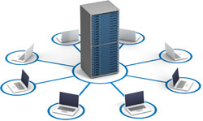
Provisioning of Resources through Configuration Management
Configuration Management (CM) is the discipline for evaluating, coordinating, approving or disapproving, and implementing changes in artifacts that are used to construct/maintain software systems
Purpose is to establish and maintain the integrity of the product/system/item being managed throughout its lifecycle
The CM policy should define:
  The set of artifacts under the jurisdiction of the CM
  How artifacts are named
  How artifacts enter/leave the controlled set
  How the artifact is allowed to change
  How different versions of artifacts are made available
  How CM tools are used to enable/enforce CM
Notes:
configuration management (CM) (1) The process of logging, auditing, and monitoring
activities related to security controls and security mechanisms over time. This data is then
used to identify agents of change, whether objects, subjects, programs, communication pathways,
or even the network itself. (2) The administration of setting up and changing configurations,
which ensures that systems are deployed in a secure consistent state and that they
stay in a secure consistent state throughout their lifetime. (3) Aka software configuration
management (SCM). The process used to control the version(s) of software used throughout
an organization and formally track and control changes to the software configuration. It has
four main components: configuration identification, configuration control, configuration
status accounting, and configuration audit. Sybex 9th ed.
Configuration Management Documentation:
Should be protected from casual observers to prevent password theft and to help prevent potential attackers from gaining information that might be useful in an attack.
Proper configuration management ensures that all hardware and software in an organization are tracked and helps to identify potential security problems.
CHANGE IS CONSTANT AND MUST BE CONTROLLED
Life cycle assurance: how a product was developed and maintained
Related terms: asset management , base lining, patch management, vulnerability management, change management
The following information should be maintained:
Make
Model
MAC address
Serial
OS / firmware version
Location
BIOS password
IP address
Bar code/label

Slide 43
Baselining
According to the National Institute of Standards and Technology (NIST), a “security control baseline” refers to “the set of minimum security controls defined for a low-impact, moderate-impact, or high-impact information system. A set of information security controls that has been established through information security strategic planning activities to address one or more specified security categorizations.”
Baseline security is the bare minimum of what a business needs to sufficiently protect itself from vulnerabilities and threats while still being able to work efficiently and effectively.
One baseline does not fit all.
Notes:
baseline The minimum level of security that every system throughout the organization
must meet. A baseline can be more than a security baseline. It can also be a performance
baseline (used by behavior-based
IDSs) or a configuration baseline (used for configuration
management). See benchmark. Sybex 9th ed.

Slide 44
Provisioning/Automation Issues
Whether you are provisioning manually or automated, the changes need to be fed to your configuration management tracking system for inclusion to the database
Automated onboarding or offboarding of software information should be made available to the configuration management database for inclusion and update.
Notes:
provisioning When needing to deploy several new instances of a server to increase resource
availability, the IT manager must preallocate hardware server resources to the new server
instances. Sybex 9th ed.

Slide 45
Provisioning Types
Grid computing provisioning: Involves the activation of servers, arrays or switches for user grid availability.
Storage Area Network (SAN) provisioning: Optimizes performance by efficiently appropriating storage to all users.
Server provisioning: Prepares a server for network operation via the installation and connection of data, software and systems.
User provisioning: Involves creating, maintaining and deactivating required business process automation objects and attributes in systems, directories and applications.
Internet access provisioning: Includes multiple client system configuration steps that vary according to connection technology and involve modem configuration, driver installation, wireless local area network (LAN) setup, Internet browser configuration, email system configuration and additional user-requested software installation.

Slide 46
Domain Objectives 7.4
7.4 Apply foundational security operations concepts
  Need-to-know/least privileges
  Separation of duties (SoD) and responsibilities
  Privileged account management
  Job rotation
  Service Level Agreements (SLA)

Slide 47
Need to Know/Least Privilege
Need to Know: If you tell people something on a need-to-know basis, you only tell them the facts they need to know at the time they need to know them, and nothing more.
Least Privilege: Privilege misuse is a top cybersecurity threat today that often results in expensive losses and can even cripple businesses.
  One of the most popular attack vectors among hackers
  The principle of least privilege (PoLP) refers to an information security concept in which a user is given the minimum levels of access – or permissions – needed to perform his/her job functions.
Notes:
principle of least privilege An access control philosophy that states that subjects are
granted the minimal access possible for the completion of their work tasks.
separation of privilege The principle that builds on the principle of least privilege. It
requires the use of granular access permissions—that is, different permissions for each type
of privileged operation. This allows designers to assign some processes rights to perform
certain supervisory functions without granting them unrestricted access to the system.
Sybex 8th ed.

Slide 48
Separation of Duties and Responsibilities
Separation of duties (SoD) is a key internal control and is the most difficult and sometimes the most costly one to achieve.
The objective is achieved by disseminating the tasks and associated privileges for a specific process among multiple people.
Notes:
separation of duties and responsibilities A common practice to prevent any single subject
from being able to circumvent or disable security mechanisms. When core administration or
high-authority responsibilities are divided among several subjects, no one subject has sufficient
access to perform significant malicious activities or bypass imposed security controls. Sybex 8th ed.

Slide 49
Functional Security Operations Concepts – Controlling Privileged Accounts
Users that require some level of special access or special privileges in order to perform a given task
Management of Privileged Entities is very important due to the fact that these entities often have the ability to bypass security controls
  System Administrators
  Operators
  Security Administrators
  Ordinary Users
  Service Account
Notes:
privileged account management (PAM) Identity and access management (IAM) solutions
that restrict access to privileged accounts or that detect when accounts use any elevated privileges.
In this context, privileged accounts are administrator accounts or any accounts that
have specific elevated privileges. Sybex 9th ed.
user Any person who has access to the secured system. A user’s access is tied to their work
tasks and is limited so they have only enough access to perform the tasks necessary for their
job position (in other words, principle of least privilege). Also referred to as an end user and
employee. Sybex 8th ed.
ISC2 refers to Privileged Entities, Shon Harris just refers to Administrative Management and separation of duties
Privilege monitoring: managing the privileged entities
Sources:
Sybex refers to privileged entity controls on page 511

Slide 50
Job Rotation
Objectives:
  Reducing Job Monotony
  Succession Planning
  Exposing Workers to All Verticals of the Company
  Testing Employee Skills and Competencies
  Developing a Wider Range of Work Experience
  Fraud detection
Notes:
job rotation A means by which an organization improves its overall security by rotating
employees among numerous job positions. Job rotation serves two functions. First, it provides
a type of knowledge redundancy. Second, moving personnel around reduces the risk of
fraud, data modification, theft, sabotage, and misuse of information. Sybex 9th ed.
Job Rotation/Rotation of Duties:
Rotation of responsibilities
Builds skill redundancy
Can mitigate fraud
Can relieve worker burnout
Some companies find the cost of job rotation not worthy of the practice
Can be implemented through mandatory vacations

Slide 51

Functional Security Operations Concepts – Service Level Agreements (SLAs)
Is a contract between vendor and customer determining service expectations
Attestation (3rd party audit or review)
Right to Pentest/Right to Audit
Secure Procurement
Vendor Governance
  Ensuring that vendors provide the expected value
Notes:
service-level
agreement (SLA), service level agreement An agreement that specifies
performance requirements for a vendor. A contractual obligation to your clients that requires
you to implement sound practices. Also used to ensure acceptable levels of service from suppliers.
This agreement may use mean time between failures (MTBF) and mean time to repair
(MTTR) as performance measures.
attestation The verification and validation of something as true and accurate.
right to audit clause A cloud service provider (CSP) service-level
agreement (SLA) statement
that gives the customer the ability to investigate performance, compliance, and violation
issues in the cloud service.
Sybex 9th ed.
Attestation 3rd party assessment of a service provider to determine security posture
Right to Pentest/Right to Audit (authority to conduct their own testing of a service provider)
Vendor Governance (vendor management) to ensure you continually get sufficient quality from 3rd party provider
Key Components of an SLA:
Services
Specifics of service provided
Conditions of service availability
Standards
Responsibilities of both parties
Escalation procedures
Cost/service tradeoffs
Management
Definitions of measurement standards and methods
Reporting process, contents, and frequency
Dispute resolution process
Indemnification clause protecting customer from 3rd party litigation due to service level breaches
Mechanism for updating the agreement as required

Slide 52
Domain Objectives 7.5
7.5 Apply resource protection
  Media management
  Media protection techniques

Slide 53
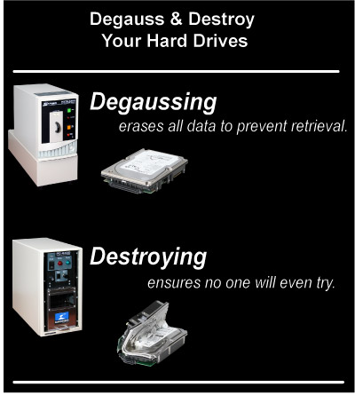
Resource Protection - Media Management
Information resides on various media types
Media may be a soft or hard copy
Media containing sensitive or confidential information should be encrypted
Removable media present different security risks
Media should be destroyed or properly disposed
Notes:
Other considerations:
Storage and Transportation
Cleaning and Destruction
Shredding
Overwriting
Degaussing
Disposal/Reuse:
Residual data must be removed
Degaussing
Overwriting tools
Destroying the media

Slide 54
Resource Protection - Media Management
Archival and Offline Storage
  Requires appropriate and suitable technical solutions be in place and that there are procedures in place to ensure that recovery can be done quickly and effectively
  Backups and archives are two methods used to store information
    May need to migrate to new media on a regular basis
    Requires regular testing
Cloud Storage
  A data storage model where the digital data is stored in logical pools
Virtual Storage
  Is the pooling of physical storage from multiple network storage devices
Notes:
Backups:
Contain info that is regularly processed by the system users
Archives:
Contains info that is needed for historical purpose but not in continual use
Cloud Storage:
Made up of many distributed resources that act as one
Highly fault tolerant thru redundancy and distribution of data
Highly durable thru the creation of versioned copies
Security concerns:
Unauthorized physical access to the data because the data is distributed among many locations
The number of people with access to the data who could be compromised
Increased number of networks the data travels over
Erroneous actions, faulty equipment, a bug or criminal activities may lead to other customers gaining access to the data
Virtual Storage:
Block virtualization: the abstraction of logical storage from physical storage
File virtualization: eliminates dependencies between the data accessed at the file level and the location where the files are physically stored
Types:
Host-based: requires additional SW running on the host as a privilege task/process
Storage device-based: supports the direct attachment of other storage controllers
Network-based: uses a network-based device (i.e. a server or smart switch) and uses iSCSI or Fibre Channel networks to connect to a SAN

Slide 55
Drive/Tape Encryption
Encryption is recommended for all portable media and devices. It can also be used for data that is static (stationary)
Whole disk encryption
  Recommended for mobile devices
  Partial encryption may not protect temporary files or unallocated space from access
Personally Identifiable Information (PII)
  Many breach laws contain exclusions for data that has been encrypted
Notes:
whole-disk
encryption (WDE) A storage security mechanism that encrypts all of the data
on a storage device with a single master symmetric encryption key. Aka full-disk
encryption
(FDE).
personally identifiable information (PII) Any data item that can be easily and/or obviously
traced back to the person of origin or concern.
Sybex 9th ed.

Slide 56
Virtual Disk Encryption
Can be accomplished by encrypting the entire virtual machine file or encrypting the drive within the virtual machine.
Tools that work within the hypervisor for virtual encryption: Bitlocker, Filevault, Boxcryptor, and PGP Whole Disk Encryption.
TPMs can be used to hold the encryption key data, but to support agility and dynamic motion of virtual machines, it should not be the method to use for virtual machines. The use of virtual TPMs have closed this gap.
Notes:
Trusted Platform Module (TPM) A cryptoprocessor chip on a mainboard used to store
and process cryptographic keys for the purposes of a hardware supported/implemented
hard drive encryption system. Sybex 8th ed.

Slide 57
Resource Protection - Problem Management
Principles of Problem Management:
  Prevent problems and resulting incidents from occurring
  Eliminate reoccurring incidents
  Minimize impact of incidents
Conflicts between problem management and incident management:
  Incident management is concerned with restoring service as quickly as possible
  Problem management is concerned with determining and eliminating the cause
Critical Success Factors (CSF)
  Avoid repeat incidents
  Minimize impact
Notes:
(ISC)2 page 663
The process of responding to events forms the basis of process management
Principles of Problem Management:
Prevent problems and resulting incidents from occurring
Eliminate reoccurring incidents
Minimize impact of incidents
Conflicts between problem management and incident management:
Incident management is concerned with restoring service as quickly as possible
Problem management is concerned with determining and eliminating the cause
Critical Success Factors (CSF)
Avoid repeat incidents
Minimize impact
57

Slide 58
Preventative Measures Against Attack
Guard against Unauthorized disclosure
Prevent destruction, interruption, and theft
Prevent corruption and improper modification

Slide 59
Domain Objectives 7.6
7.6 Conduct incident management
  Detection
  Response
  Mitigation
  Reporting
  Recovery
  Remediation
  Lessons learned

Slide 60
Investigations – Policies, Roles and Responsibilities
Corporate incident handling and response policy
  Articulated procedures and guidelines that consider legal requirements
  Management and handling of evidence
Staff can be virtual (additional duty) or permanent
Core areas to represent on response team
  Legal, human resources, communications, executive management, physical security, internal audit, IS security and IT
  Business units and various system administrators
Notes:
Sometimes called CSIRT (computer security incident response team)
Receive alerts, do forensics, from different areas of business, internal part of DR plan, pen testing etc.
Skillport 2018 CISSP
computer security incident response teams (CSIRTs) A dedicated team responsible for
investigating any computer security incidents that take place. Aka cyber incident response
teams (CIRTs) or incident response teams (IRTs). Sybex 9th ed.

Slide 61

Investigations – Incident Response
Develop a response capability
Incident Handling and Response
  Triage Phase (detect, identify, notify)
    Identify false positives
  Investigative Phase (collect relevant data)
  Containment Phase
  Analysis and Tracking Phase
    Verify containment coverage
  Root Cause Analysis
Recovery Phase
  Recovery, repair and prevention
Debriefing/Feedback
Notes:
incident response, incident response plan (IRP), incident response procedure (IRP)
A planned action to take to handle any violations of security policy. The SOP that defines
how to prevent incidents, how to detect incidents, how to respond to incidents, and how to
return to normal when the incident is concluded. Aka incident response procedure, incident
response process, or incident management.
computer security incident A violation, or imminent threat of a violation, of a security
policy or practice within the organization. Computer security incidents are the result of an
attack, malware infection, or inappropriate usage by employees.
Sybex 9th ed.
Incident: Any event that has the potential to negatively impact the business or its assets. It is up to the organization to categorize events that warrant the activation of the incident response escalation process.
computer security incident A violation, or imminent threat of a violation, of a security
policy or practice within the organization. Computer security incidents are the result of an
attack, malware infection, or inappropriate usage by employees. Sybex 8th ed.
Incident Response: aka Incident Handling
Do not confuse IR with Computer or Network Forensics, they are NOT synonymous.
Should be managed by the legal department, which makes the investigation and results privileged as an attorney work-product.
IT personnel are like cops: determine if crime committed; secure crime scene, collect evidence
Primary Goal: To contain and mitigate any damage caused by an incident and to prevent any further damage.
Response Capability: The foundation for Incident Response … as always, the first step begins with the Policy!
Incident Response Policy: Provides direction for employees. The Policy should:
State who has the authority to initiate an incident response.
Be supported by more specific documents that establish procedures and guidelines.
Must be clear, concise, and provide a mandate for the Incident Response/Handling team.
Have an Escalation Process - Employees should be trained and have approved procedures on when evidence of a crime must be reported to higher management, outside agencies, or law enforcement.
Have a process for interacting with third party entities - Such as the media, government, and law enforcement authorities.
Response Team (CIRT or CSIRT): Needs to be comprised of the correct people and they should be provided the appropriate training in how to react to incidents legally and effectively.
An approved handling process is key to ensure that a methodical approach be followed. A methodical approach allows for the proper documentation and collection of information that may be of importance to the later stages/phases of the response.
Triage: The incident is accurately and precisely identified and classified, and appropriate notification is made. Think like the triage performed by EMTs at the scene of a car accident. Contains detection, identification and notification subphases
Investigative Phase: To properly collect relevant data.
Containment: To stop further damage; take the server off of the network (if feasible).
Analysis and Tracking: To review the collected data and maintain data related to the incident; who did this, how they did it, when and why.
Recovery Phase: To get back up and running … this phase is crucial.
Recovery and Repair: Recover the affected system to production status; implement fixes to ensure it doesn’t happen again; ensure system can withstand another attack; test for vulnerabilities and weaknesses to provide information assurance.
Debriefing/Feedback: Very important. Once an incident has been deemed closed, the incident handling process is not yet done.
A formal process should be in place to document what worked well, what did not work well, what was totally unexpected (AAR for those of you with military backgrounds).
The results of the feedback process should be used to make the changes necessary to prevent future incidents, improve detection and response procedures for incidents, and amend policies as needed.
Include all team members and group affected by the incident.
Use output to adapt or modify policy and guidelines: A side benefit to the formalism of the debriefing/feedback is the ability to start collecting meaningful data that can be used to develop/track performance metrics for the response team.
Incident response basic steps:
preparation, detection, containment, analysis, eradication, recovery, follow-up
Fiduciary Responsibility: legal duty or responsibility to protect the assets of a company or other party with honesty and integrity

Slide 62
NIST Incident Handling Guide
NIST Incident Response steps:
  Preparation
  Detection and Analysis
  Containment, Eradication, and Recovery
  Post Incident Activity
Standard Six Step Model
  Preparation
  Detection and Analysis
  Containment
  Eradication
  Recovery
  Lessons Learned
CISSP Breakdown
Preparation
Detection
Response
Mitigation
Reporting
Recovery
Remediation
Lessons Learned

Slide 63
Incident Third Party Considerations
Public/private/hybrid environments rely heavily on outsourced or third party services. They need to be included in your incident management program
Pre-incident
  Prediction (is the 3rd party cooperating and meshing with your plan)
  Detection (Does the 3rd party warn/take action/minimize probability/impact of an incident)
During the incident
  Response (verify contracts/SLAs are meeting agreed upon expectations)
Post-incident
  Recovery and reporting (are recovery times in sync)
  After action (coordinate incident cause and prevention)

Slide 64
Incident Response - Root Cause Analysis (RCA)
Focuses on determining the root cause of an incident
Goes deeper than identifying only the symptoms
Burrowing down through a problem until a single cause is evident
Determine the history of an event and work backwards to ascertain the cause
RCA can cross boundaries between the technical, administrative and cultural areas
Senior management must support the analysis to be successful
Notes:
root cause analysis An operational investigation that seeks to identify the reason that an
operational issue occurred. The root cause analysis often highlights issues that require remediation
to prevent similar incidents in the future. Sybex 9th ed.
Some policies may forbid incident response handlers to traceback or track the attacker.

Slide 65
Domain Objectives 7.7
7.7 Operate and maintain detective and preventative measures
  Firewalls (e.g. next generation, web application, network)
  Intrusion detection Systems (IDS) and Intrusion prevention systems (IPS)
  Whitelisting/blacklisting
  Third-party provided security services
  Sandboxing
  Honeypots/honeynets
  Anti-malware
  Machine learning and Artificial Intelligence (AI) based tools

Slide 66
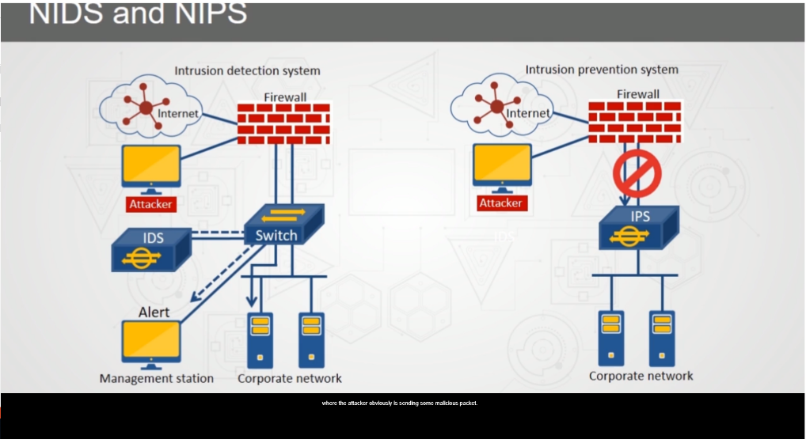
Preventative Measures Against Attack – Network Intrusion Detection System (NIDS) Architecture
Incorporated into the network in a passive architecture (i.e. minimum impact to the network)
Analyzes the contents of every packet
May be active or passive in nature
Does not inspect encrypted packets
Host-Based Intrusion Detection (HIDS) is the implementation of IDS capabilities on a host level)
Notes:
network-based
IDS (NIDS), network-based
IPS (NIPS) An intrusion detection system
(IDS) or intrusion prevention system (IPS) approach that attaches the system to a point in the
network where it can monitor and report on all network traffic. Sybex 9th ed.
network-based IDS (NIDS) An IDS installed onto a host to monitor a network. Networkbased
IDSs detect attacks or event anomalies through the capture and evaluation of network
packets.
host-based IDS (HIDS) An intrusion detection system (IDS) that is installed on a single
computer and can monitor the activities on that computer. A host-based IDS is able to
pinpoint the files and processes compromised or employed by a malicious user to perform
unauthorized activity.
Graph- Skillport 2018 CISSP

Slide 67
Preventative Measures Against Attack – Intrusion Detection System (IDS) – Analysis Engine Methods
Stateful Matching Intrusion Detection
  Overall behavior rather than individual packets
Statistical Anomaly-Based Intrusion Detection
  Patterns that deviate from the predicted norm
Protocol Anomaly-Based Intrusion Detection
  Deviation from expected behavior of known protocols
Traffic Anomaly-Based Intrusion Detection
  Deviation from expected behavior based on traffic structure

Slide 68
Whitelisting/Blacklisting
Whitelisting: Whitelisting is a cybersecurity strategy under which a user can only take actions on their computer that an administrator has explicitly allowed in advance.
  Proactive
  Instead of trying to keep one step ahead of cyberattackers to identify and block malicious code, IT staff instead compiles a list of approved applications that a computer or mobile device can access.
Blacklisting: involves defining which entities should be blocked.
  Reactive
  A blacklist is a list of suspicious or malicious entities that should be denied access or running rights on a network or system.

Slide 69
Third Party Security Services
Third party tools and services can bring value to your enterprise security. Local applications and services do not always contain protection methods and use of third party tools can fill the gap. Third party solutions can also add risk with the addition of their vulnerabilities or lack of foresight during development.

Slide 70
Preventative Measures Against Attack – Third-Party
Sandboxing - lets programs and processes run in their own isolated virtual environment
Anti-Malware - tools used for malware and virus mitigation
Honeypot - decoy servers/systems set up to gather information about an attacker/intruder
  Entrapment
  Enticement
Honeynet - two or more honeypots on a network and is used for monitoring a larger and more diverse network
Honeyfarm - a centralized collection of honeypots and analysis tools
Notes:
sandboxing A security technique that provides a security boundary for applications and
prevents the application from interacting with other applications. Anti-malware applications
use sandboxing techniques to test unknown applications. If the application displays
suspicious characteristics, the sandboxing technique prevents the application from infecting
other applications or the operating system. Sybex 8th ed.
honeyfiles False work files that are used to tempt intruders or problematic insiders.
honeynet Two or more networked honeypots used in tandem to monitor or re-create
larger, more diverse network arrangements. See honeypot.
honeypot, honeynet A honeypot is an individual computer created to serve as a snare for
intruders. An entire network created for this purpose is known as a honeynet. The honeynet/
honeypot looks and acts like a legitimate system, but it is 100 percent fake. Honeynets/honeypots
tempt intruders with unpatched and unprotected security vulnerabilities as well as
hosting attractive, tantalizing, but faux data. Honeynets/honeypots are designed to grab an
intruder’s attention and direct them into the restricted playground while keeping them away
from the legitimate network and confidential resources.
Sybex 9th ed.
Honey pot
Area filled with information that is seemingly valuable but is actually fabricated
Would not be accessed by an honest user
When accessed, the attacker can be delayed while information can be collected about their activities
Collect Evidence
Common honeypots:
Glastopf – open source honeypot that emulates a vulnerable web server
Specter – commercial honeypot and can trace hackers
Ghost USB – free USB emulation honeypot that mounts as a fake USB drive for capture and analysis of malware
KFSensor – Windows based honeypot IDS that simulates vulnerable system services and trojans
Entrapment:
Neither Legal nor Ethical
Encourages the commission of a crime that the individual initially had no intention of committing
When an intruder is actively solicited to a site and then charged with unauthorized intrusion
Enticement:
Legal and Ethical
Occurs after an individual has gained unauthorized access to a system “on their own”
The intruder then is lured to an attractive area (honeypot) to provide time to determine the origin of the intrusion and eventually the identity of the intruder
After that individual has already committed a crime
Is not necessarily illegal but does raise ethical arguments and may not be admissible in court
Padded cell:
A padded cell, like a honey pot, transfers an attacker into a safe area
The attacker is now in a simulated environment where no harm can be caused
Pseudo flaw:
A flaw created to attract an attacker
Does not create a vulnerability

Slide 71
Preventative Measures Against Attack – Anti -Malware Testing Standards Organization (AMTSO)
Four areas of focus
  Discussion forum on testing of anti-malware
  Developing and publicizing standards and best practices
  Promoting anti-malware education and awareness
  Providing tools and resources to aid standard based testing
Support two “Feature Settings Check” webpages that allow one to test their anti-malware solutions
  Windows
  Android

Slide 72
Knowledge Management
Corporate / Organizational Memory
  All the information an organization might possess
  Grouped into a data warehouse
Knowledge Discovery in Databases (KDD)
  Mathematical, statistical, and visualization method of identifying valid and useful patterns in data
  Mostly used via artificial intelligence
Notes:
72
Sources:
Sybex CISSP Study Guide 4th Edition (pgs. 261-263)

Slide 73

Expert Systems
Rule Based (on If-Then Logic)
  Uses artificial intelligence
Built by Knowledge Engineers (analysts)
  Emulates human logic to solve problems
  A.k.a. Knowledge-based system
Example:
  Optical Character Recognition (OCR)
    Used by scanners and other optical readers
Components
  Inference Engine
  Knowledgebase
Notes:
73
expert system A system that seeks to embody the accumulated knowledge of humankind
on a particular subject and apply it in a consistent fashion to future decisions.
Takes emotion out of quick decision making… like stock trading or emergency events. Sybex 8th ed.
inference engine The second major component of an expert system that analyzes
information in the knowledge base to arrive at the appropriate decision.
knowledge base A component of an expert system, the knowledge base contains the rules
known by an expert system and seeks to codify the knowledge of human experts in a series
of “if/then” statements.
Sybex 9th ed.
Rule Based: The rules are based on if-then logic units and specify a set of actions to be performed for a given situation.
Systems are built by a Knowledge system builder (programmer), a knowledge engineer (analyst), and a subject matter expert.
Systems are built on facts, rules of thumb and expert advice.
Inference Engine:
Analyzes info in the knowledge base to arrive at the appropriate decision.
Provides the necessary rules for the system to take original facts and combine them to form new facts.
Knowledgebase: contains the rules known by an expert team.
Sources:
Shon Harris CISSP All-in-One Exam Guide 4th Edition (pgs. 975-977)

Slide 74

Neural Networks
Based on the neural structure of the brain
  Programmed with the capability to decide and learn to improve its decision functionality
Capability to “learn”
Intelligent “Vacuum Cleaner”
Voice recognition, weather prediction, etc.
Security Controls:
  Protect knowledge base, routinely verify decisions against specific input, change control process for logic changes, verify suspicious input data, risk management decisions could be incorrect, develop a baseline.
Notes:
74
neural network A system in which a long chain of computational decisions that feed into
each other and eventually add up to produce the desired output is set up.
Detect anomolies in massive amounts of audit log data.
Sybex 8th ed.
delta rule The feature of neural networks that allows them to learn from experience.
Aka the learning rule. Sybex 9th ed.
Neural Networks: an electronic model based on the neural structure of the brain. Neural Networks contain many units that simulate neurons, each with a small amount of memory. The units work on data that are input through their many connections. Via training rules, the systems are able to learn from examples and have the capability to generalize.
Neural networks are non-linear statistical data modeling tools. They are used for fuzzy solutions where exactness is not required. I.E. weather prediction.
Single layer: one layer of input nodes
Multi layer – multiple layers to include hidden nodes
Bayesian filtering: used to identify spam through tokens (words in email). Used for calculating conditional probabilities
Brain: 100 billion neurons connected by thousands of synapses.
Sources:
Shon Harris CISSP All-in-One Exam Guide 4th Edition (pgs. 977-979)

Slide 75
Domain Objectives 7.8
7.8 Implement and support patch and vulnerability management

Slide 76

Patch and Vulnerability Management
Formalize procedures through change and configuration management
Objective is to create a consistently configured environment that is secure against known vulnerabilities in OSs and application SW
Patch testing should address proper functionality of the system and the overall effect the patch has on the state of security or policy of the system
Key component is the intake and vetting of information regarding both security issues and patch release
Notes:
patch management Program that ensures that relevant patches are applied to systems.
Ideally, patches are evaluated, tested, and deployed, and systems are audited to verify that the
patches are applied and not removed.
vulnerability management A program used to detect weaknesses within an organization.
Vulnerability scans and vulnerability assessments are two common elements of a vulnerability
management program. Vulnerability scans are technical scans performed regularly, and
vulnerability assessments are normally combined with a risk assessment.
Sybex 9th ed.
Be careful of the interdependencies… Process should verify effect a change to one configuration item has on other systems.
-Skillport CISSP 2018
Information Protection Management:
Should be required procedures for changing, accepting, and testing software
Management Approval
Patch Management
Change Management
Configuration Management
Product flaws are unavoidable.
Other considerations:
Security patches are tied to a particular vulnerability
Back up systems prior to performing updates
Schedule patching process and do it in stages
Confirm updates with system management tools and vulnerability scanners
Document the changes. Also include comments when a change was not implemented and the approving authority for doing so
Critical part of change control management involving security updates
The patch management process must be formal, documented, and done with management’s approval to provide the best possible strategy for change
(ISC)2 page 663
The process of responding to events forms the basis of process management
Software changes or patches must be authorized, tested in a controlled environment and recorded so they can be reversed if necessary
Request Control: Organized framework in which users can request modifications, managers can conduce cost/benefit analysis, and developers prioritize tasks
Change Control: Way of controlling the lifecycle of an application and documenting the necessary change control activities
Release Control: Once finalized, releases must be approved for release through specific procedures
Steps: request change, senior management approval, start documentation (change log), testing, implementation, report completion of change to management
Sources:
(ISC)2 CBK 2008 (pgs. 584-586)
Sybex CISSP Study Guide 4th Edition (pgs. 503-504)
Shon Harris CISSP All-in-One Exam Guide 4th Edition (pgs. 953-955, 986)

Slide 77
Domain Objectives 7.9
7.9 Understand and participate in change management processes

Slide 78
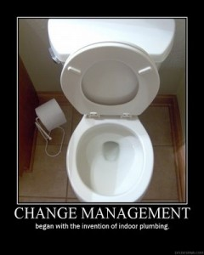
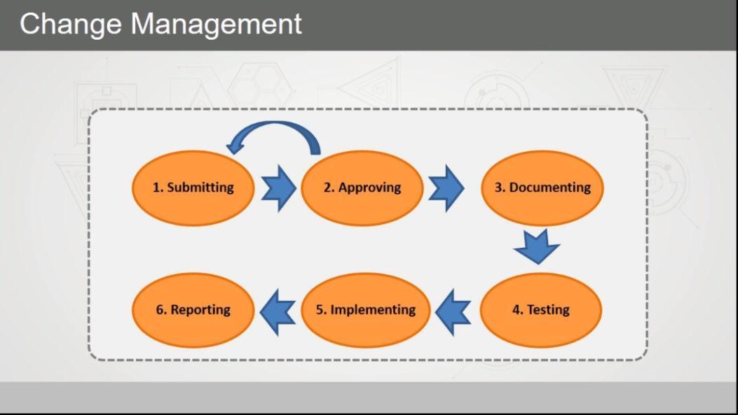
Change and Configuration Management
Change Control Management is the process of maintaining system integrity
  Requests
  Impact Assessment
  Approval/Disapproval
  Notification
  Implementation
  Validation
  Documentation
Configuration Management is a process for identifying and documenting HW components, SW, and the associative settings which ensures that resources are properly deployed and managed
  Requires a detailed inventory of HW and SW
Notes:
change management A process that helps prevent unintended outages. Before personnel
make a configuration change to a system, they submit a change request. Other personnel
review the change. If approved, the change is tested, implemented, and documented.
configuration management (CM) (1) The process of logging, auditing, and monitoring
activities related to security controls and security mechanisms over time. This data is then
used to identify agents of change, whether objects, subjects, programs, communication pathways,
or even the network itself. (2) The administration of setting up and changing configurations,
which ensures that systems are deployed in a secure consistent state and that they
stay in a secure consistent state throughout their lifetime. (3) Aka software configuration
management (SCM). The process used to control the version(s) of software used throughout
an organization and formally track and control changes to the software configuration. It has
four main components: configuration identification, configuration control, configuration
status accounting, and configuration audit.
Sybex 9th ed.
Change Control:
CRITICAL FOR LIFECYCLE
Maintains system integrity through structured and control changes
Change decisions should be made by a committee of people from many groups within the organization
Proper steps should be taken to ensure that changes to a system do not lower its security posture
Configuration/change management controls provide a process by which all system changes are tracked, audited, controlled, identified, and approved
Requires rigorous testing prior to being deployed in a production environment
Requires documentation and allows for training of users
Change in a secure environment can introduce loopholes or oversights that can lead to new vulnerabilities. This is the reason patch management is critical; in order to protect information systems the patches must be tested prior to implementing them. They can cause problems in other areas.
Ensure any change does not lead to reduced or compromised security, making it possible to roll back any change to a previous secured state.
Configuration of change management has several goals and requirements:
Implement changes in a monitored and orderly manner; changes are always controlled.
A formalized testing process is included to verify a change produces expected results.
All changes can be reversed
Users are informed of changes before they occur to prevent loss of productivity.
The effects of changes on capabilities, functionality, and performance is minimized.
Parallel run – process is performed simultaneously on each system to ensure the new system supports all functionality the old system supported or provided
Change Control Management process:
Request: formal request for a change are presented in writing with detailed justification focusing on benefits of implementation and costs of not implementing
Impact Assessment: impacts to operations are considered as a basis to approve or disapprove
Approval/Disapproval: change requests are officially answered
Notification: system users are notified of the change and when it will be deployed
Implementation: when possible, changes are applied incrementally and monitored thoroughly
Validation: changes to systems are reviewed and security scans are performed to ensure no unintended changes are made or that the security level of a system has been lowered and record in the problem tracking system until operations is sure no new problems have been introduced
Documentation: all changes are recorded, along with problems and/or solutions in the configuration management database and track lessons learned during the change process
Configuration Management:
ID – Document the configuration of SW products in the organization
Control – ensures changes to SW are made in accordance with policies and only from authorized distributions of SW
Status Accounting – formalized procedures are used to keep track of all authorized changes that take place.
Audit – periodic configuration audit should be conducted to ensure actual production environment is consistent with accounting records and no unauthorized configurations took place.
Sources:
(ISC)2 CBK 2008 (pgs. 584-586)
Sybex CISSP Study Guide 4th Edition (pgs. 503-504)
Shon Harris CISSP All-in-One Exam Guide 4th Edition (pgs. 953-955, 986)
From Shon Harris page 1045-1046
Request for a change to take place
Approval of the change
Documentation of the change
Tested and presented
Implementation (monitor/train)
Report change to management
CREATE APPROVED BACK OUT PLANS PRIOR TO IMPLEMENTATION THAT WILL RESTORE ORIGINAL STATE
Why is change control important? Give an example.
Change Control Board: oversees and coordinates change control process
General flow:
Identify a change
Propose a change (to management)
Assess the risk associated with the change (reversible? Rollback plan?)
Test change
Schedule change
Notify impacted parties
Implement change
Report results (to management)
Graphic- Skillport CISSP 2018
78

Slide 79
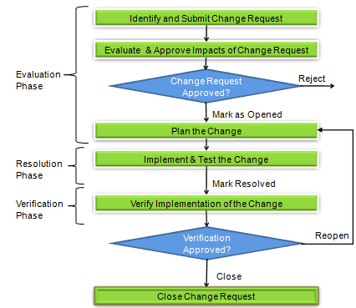
Change and Configuration Management – Change Control Process
Changes are always controlled
Formalized testing process
Ability to reverse changes
Users informed of impending changes
Change effects are analyzed
Minimizes negative impact of changes
Notes:
configuration management The process of logging, auditing, and monitoring activities
related to security controls and security mechanisms over time. This data is then used to
identify agents of change, whether objects, subjects, programs, communication pathways,
or even the network itself. Sybex 8th
Change Control:
CRITICAL FOR LIFECYCLE
Maintains system integrity through structured and control changes
Change decisions should be made by a committee of people from many groups within the organization
Proper steps should be taken to ensure that changes to a system do not lower its security posture
Configuration/change management controls provide a process by which all system changes are tracked, audited, controlled, identified, and approved
Requires rigorous testing prior to being deployed in a production environment. DO ON A CLONE OF SYSTEM?
Requires documentation and allows for training of users
Change in a secure environment can introduce loopholes or oversights that can lead to new vulnerabilities. This is the reason patch management is critical; in order to protect information systems the patches must be tested prior to implementing them. They can cause problems in other areas.
Ensure any change does not lead to reduced or compromised security, making it possible to roll back any change to a previous secured state.
Configuration of change management has several goals and requirements:
Implement changes in a monitored and orderly manner; changes are always controlled.
A formalized testing process is included to verify a change produces expected results.
All changes can be reversed
Users are informed of changes before they occur to prevent loss of productivity.
The effects of changes on capabilities, functionality, and performance is minimized.
Parallel run – process is performed simultaneously on each system to ensure the new system supports all functionality the old system supported or provided
79

Slide 80
Change and Configuration Management – Configuration (Change) Control Board (CCB)
Typically oversees and coordinates the change control process
Gathers and documents sufficient details to understand the change
The decision to implement the change and the timeliness will be driven by principles of risk and cost management
Business continuity planners should be members of the board to assess the changes effect on recovery procedures
Notes:
Depending on the size of the organization the board may be a less formal group or perhaps just one or two individuals

Slide 81
Domain Objectives 7.10
7.10 Implement recovery strategies
  Backup storage strategies
  Recovery site strategies
  Multiple processing sites
  System resilience, high availability (HA), Quality of Service (QoS), and fault tolerance

Slide 82
Change and Configuration Management – System Resilience and Fault Tolerance Requirements
Maintain the security and reliability of key computing systems to ensure it is:
  Resilient
  Capable of reacting automatically to common failures and address the problem without human intervention
Trusted paths provide trustworthy interfaces into privileged user functions
  Intended to ensure that communication paths cannot be intercepted and includes:
    Fail-Safe – mechanisms focus on failing with a minimum of harm to personnel or system
    Fail Secure – focuses on failing in a controlled manner to block access while the system is in an inconsistent state
Notes:
Fault Tolerance: roll forward –correct system state
Fault Tolerance: roll back – revert to previous correct state, check points, snapshots, save points
Fail-Safe/Fail-Secure
Failure state puts the system into a high level of security and possibly disables activities until the problem can be corrected
Prevents unauthorized access to info and resources and allows troubleshooting
Fail-Safe/Fail-Secure
Places system into high level of security
Fail-Open
Allows users to bypass failed security controls
Sources:
Sybex CISSP Study Guide 4th Edition (pgs. 127, 265-266)
(ISC)2 CBK 2008 (pgs. 571-582)
Shon Harris CISSP All-in-One Exam Guide 4th Edition (pgs. 298, 327-328, 343-344)
82

Slide 83
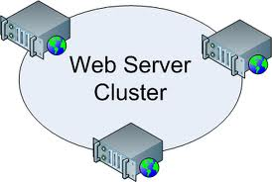
Redundancy and Fault Tolerance – System Resilience and Fault Tolerance Requirements
Involves using redundant servers or networks and redundant data storage
Spares are components that are available if a primary component is damaged or unavailable
  Cold spare
  Warm spares
  Hot spares
High Availability Clusters (failover clusters)
  Active-Active
    Load balancing (hot spare)
  Active-Passive
    Hot standby (warm spare)
    Located in storage (cold spare)
Notes:
fault tolerance The ability of a system to suffer a fault but continue to operate. Fault
tolerance is achieved by adding redundant components such as additional disks within a
redundant array of independent disks (RAID) or additional servers within a failover clustered
configuration.
redundant servers A fault-tolerant deployment option that provides for various server
options in the event of a disaster, such as mirroring, electronic vaulting, remote journaling,
database shadowing, and clustering.
clustering (or key clustering) A weakness in cryptography where a plaintext message
generates identical ciphertext messages using the same algorithm but different keys.
Sybex 8th ed.
Clustering:
Hardware that has long repair or procurement time frames
Backup systems for ones that are error prone
Service Level Agreements with service providers
Additional items requiring redundancy:
Power supplies
Disc drives
Data storage
83

Slide 84
Redundancy and Fault Tolerance – Drives and Data Storage
Storage Area Network (SAN)
  Operates at block level
  Dedicated storage on a dedicated network
Network Attached Storage (NAS)
  Operates at the file level
  Typically on a shared network and can be mapped as network drives
Notes:
A Storage Area Network is a high-speed sub network of shared storage devices. A SAN's architecture works in a way that makes all storage devices available to all servers on a LAN or WAN. As more storage devices are added to a SAN, they too will be accessible from any server in the larger network.
Network-attached storage (NAS) is dedicated file storage that enables multiple users and heterogeneous client devices to retrieve data from centralized disk capacity. Users on a local area network (LAN) access the shared storage via a standard Ethernet connection.

Slide 85

Drives and Data Storage – Redundant Array of Independent Tapes (RAIT) Levels
Used with tape vaulting to make multiple copies of tapes for backup and recovery
Relays on robotic mechanisms to automatically transfer tapes between the storage and the drive mechanisms

Slide 86
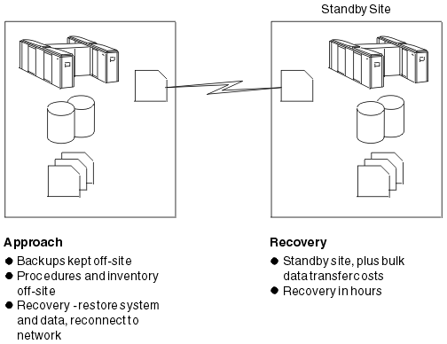
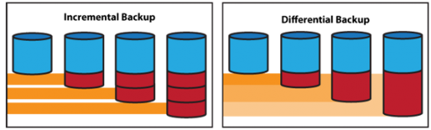
System Resilience and Fault Tolerance Requirements – Backup and Recovery Systems
Electronic Backups
  Full
  Incremental
  Differential
  Electronic Vaulting
  Remote Journaling
Off-Site Storage (RTO 3-5 days)
Tape vaulting
  Tape rotation methods
Database Shadowing
High Availability Options
Software Escrow
Hardcopy Data
Notes:
full backup A complete copy of data contained on the protected device on the backup media.
This process also clears the archive bit or changes the timestamp of files upon completion.
incremental backup A type of backup that includes only new files or files that have
changed since the last full backup or the last incremental backup. Incremental backups clear
the archive bit or change the timestamps of files on completion.
differential backup A type of backup that copies only new files or files that have
changed since the last full backup onto the backup media. Differential backups differ from
incremental backups in that they don’t clear the archive bit or change the timestamp on
completion.
electronic vaulting A storage scenario in which database backups are transferred to a
remote site in a bulk transfer fashion. The remote location may be a dedicated alternative
recovery site (such as a hot site) or simply an off-site location managed within the company
or by a contractor for the purpose of maintaining backup data.
remote journaling Transferring copies of the database transaction logs containing the
transactions that occurred since the previous bulk transfer.
software escrow agreement (SEA), software escrow arrangement A risk management tool
that can protect a company against the failure of a third-party
software developer. An SEA can
address whether the developer is able to provide adequate support for its products or against the
possibility that the developer goes out of business. Under an SEA, the developer provides copies
of the source code to an independent third-party
organization, i.e., the escrow organization.
Sybex 9th ed.
Covered by backup , retention, and destruction policies
Full- copy all data (set archive bit to zero); if the file is changed or created, then set to 1
Incremental – copy all data with archive bit set to one (reset to zero) and backs up changes since last incremental
Differential – copy all data with archive bit set to one (no reset) and backs up since last full
Electronic vaulting: fastest recovery if OS, patches, apps are also backed up over a network, usually to a separate geographical location (this is known as the vault site)
Batch processing, scheduled, good for backups and offsite
Can be used as a mirror or backup mechanism
Real time or delayed
Remote Journaling: transmitting the journal or transaction log offsite to a backup facility
Provides redundancy for transactions
the DBMS duplicates the journal entry to a remote location
Transaction logs: saves database checkpoints and database journal to a remote site
Off-Site Storage: is a secure location away from the primary facility that provides assurance of recovery in the event that the facility is destroyed
Tape vaulting: data sent over a serial line to a backup tape system offsite
Disk shadowing: similar to mirroring
HA - high availability cluster - good for MTD of zero
Active-active cluster: multiple systems online and actively processing data (AKA load balancing)
Active-passive cluster – devices in place and ready to go if needed (hot spares, standby, failover-cluster)
Software Escrow: storing source code of SW with a 3rd party escrow agent and is available to the organization should the vendor go out of business
Hardcopy Data: paper-based data
Disk duplexing: having a backup disk controller
GRANDFATHER-FATHER-SON method: year-month-week (example)
TERTIARY STAGE (second order) back up to CD than then moved to tape for long term storage.
Other terms: shadowing, mirroring, redundant servers, clustering, RAID, backups, dual backbones, direct access storage device, redundant power, mesh topology
Prestaging OS, fastest recovery process, maintains duplicates
Needs continuous or periodic synchronization

Slide 87
System Resilience and Fault Tolerance Requirements – Archive Bit
Example from a master file table ($MFT) record
$FILE_NAME 1:
ParentSequenceNo: 1
CreationTime (CTime): 2013-06-24 21:10:46:101:7529
LastWriteTime (ATime): 2013-06-24 21:10:46:101:7529
ChangeTime (MTime): 2013-06-24 21:10:46:101:7529
LastAccessTime (RTime): 2013-06-24 21:10:46:101:7529
AllocSize: 0
RealSize: 0
Flags: archive (ARCHIVE BIT VALUE)
NameLength: 9
NameType: DOS+WIN32
NameSpace: 8
FileName: newfile.txt
Notes:
archive bit A file header flag that indicates that a file is either new or changed. The archive
bit is a common feature on Windows file systems. Other OSs often use the change timestamp.
CTime means File Create Time.
ATime means File Modified Time.
MTime means MFT Entry modified Time.
RTime means File Last Access Time.

Slide 88
Change and Configuration Management – Develop a Recovery Strategy
Surviving site
Self-service
Internal arrangement
Reciprocal/Mutual Aid Agreements
Dedicated alternate sites
Work from home
External suppliers
No arrangement
Notes:
Surviving site: service levels may drop but a function never ceases because it operates in at least two geographically dispersed buildings that are fully equipped and staffed.
Self-service: Business transfers work to another of its locations
Internal arrangement: training rooms, cafeterias, conference rooms, etc. may be equipped to support business functions while staff travel from the impacted site to another site
Reciprocal/Mutual Aid Agreements: arrange with a similar business to accommodate during the disruption
Dedicated alternate sites: built by the company to accommodate organization function or technology recovery
Work from home: employees work from locations remote from a physical office environment
External suppliers: use an external company that offers recovery needs
No arrangement: For low priority business functions or applications or that may not be cost justified.

Slide 89
Domain Objectives 7.11
7.11 Implement Disaster Recovery (DR) processes
  Response
  Personnel
  Communications
  Assessment
  Restoration
  Training and awareness
  Lessons learned

Slide 90
The Disaster Recovery Process (DRP)
Is the process of restoring services from a contingency state
Personnel Safety Top Priority (Safety Trumps Everything)
There must be an initial response that assesses the situation
  The initial response needs to work quickly to determine the need for an alternate site and to gauge the safety of the workforce

Slide 91

Disaster Recovery Plan (DRP) – Steps
Respond
Activate Team
Communicate
Assess
Reconstitution
Notes:
disaster recovery plan A document that guides the recovery efforts necessary to restore
your business to normal operations as quickly as possible.
disaster recovery planning (DRP) Term that describes the actions an organization takes
to resume normal operations after a disaster interrupts normal activity.
Sybex 8th ed.
disaster recovery plan (DRP) The collection of detailed procedures used in the event that
business functions are interrupted by a significant damaging event, with the goal of restoring
partial or normal operations. Sybex 9th ed.

Slide 92
Disaster Recovery Plan (DRP) – Documentation
Document the DRP plan once recovery strategies have been developed
  Should be detailed enough to perform the recovery
  Should be stored offsite (i.e. recovery location)
  Should be tested and updated as needed
  Use version control
Event Management Process
  Is about communication and response during non-disaster and disaster events
  Is triggered by an event which is anything that either already has or has the potential to cause a significant organizational interruption
Notes:
Recovery Plan Documentation breakdown:
Executive summary
Department-specific plans
Technical guides for IT personnel
Checklists for disaster recovery team
Full copies for critical DRP team members
Event Management requirements:
Strategy must be consistent regardless of event
Need to be establish an assessment process
Event ownerships needs to be defined
Management team identified
Response team identified
Process for gathering of key decision makers
Methods of communication need to be defined
Event Management goals:
Single source of info
Triage
Rapid escalation
Consistent problem management
Rumor control
Make sure everyone who need to know does
Allow the problem solvers room to solve
Playbook which documents key roles and responsibilities

Slide 93
Disaster Recovery Plan (DRP) – Response
A central communications group (i.e. an Emergency Operations Center (EOC)) is responsible for initiating communications to those who:
  Must respond to the event
  Are impacted by the event
Event Management Plan:
  Is part of the Business Continuity Plan (BCP) & DRP
  Identifies who:
    Is authorized to declare a disaster
    How a declaration is done
    When the decision to ‘declare’ is made
    How it will be communicated to the teams that need to respond
Notes:
Emergency Operations Center (EOC):
Two or three possible locations
First, is the primary building location
A site relatively close to original location
A site farther away in case of regional disaster
Two fundamental scenarios
Disaster has occurred, but the physical location is not affected. People can stay at work and continue working
Disaster has occurred and the physical location is affected. People have to relocate
The EOC becomes the central control center for recovery operations. An efficiently equipped EOC will have a large number of workstations, phones, tables, chairs, whiteboards, office supplies, and communication equipment.
Manned by the crisis management team (CMT). The CMT is called out to manage the enterprise during a disaster situation and facilitates communication with other teams.

Slide 94
Disaster Recovery Plan (DRP) – Executive Emergency Management Team
Made up of senior executives
Responsible for overall recovery of organization
Not concerned with day to day operations
Responds to and assists in the resolution of issues which need their direction
Spokesperson for the organization to the media
Decision maker on how the organization will manage the business impacts of the event
Notes:
Executives are concerned with strategic issues not with tactical delivery
Crisis management versus crisis leadership
Managing vs. leading
React anticipate
Short term long term
Process principles
Narrow wide focus
Tactical strategic

Slide 95

Disaster Recovery Plan (DRP) – Crisis Management Plan
Provides effective coordination between managers in the event of a disruptive event
Consists of:
  Crisis Communications Plan
  Call Trees
  Emergency Operations Center
  Vital Records
Notes:
Crisis management plan
A crisis management plan (CMP) is a document that outlines the processes an organization will use to respond to a critical situation that would negatively affect its profitability, reputation or ability to operate. https://searchdisasterrecovery.techtarget.com › definition › crisis-managemen...

Slide 96

Disaster Recovery Plan (DRP) – Vital Records
Records needed to rebuild the business are stored offsite
  Secure location accessible after a disaster
Common vital records (Legal)
Common vital records (Business)
Notes:
Common vital records (legal):
Anything with a signature
Customer correspondence/conversations
Accounting records
Justification proposals/documents
Transcripts/minutes of meetings with legal significance
Paper with value (stock certificates, bonds, commercial paper)
Legal documents (letters of incorporation, deeds)
Common vital records (Business)
Databases and contact lists for employees, customers, vendors, partners, or others
Business unit’s contingency plan
Procedure /application manuals
Backup files from production servers
Applications
Reference documentation
Calendar files or printouts with schedules and appointments
Source code
(ISC)2 CBK pgs 273-275

Slide 97
Disaster Recovery Plan (DRP) – Personnel and Communications
Human resource issues need to be addressed depending on the disaster and may include:
  Providing temporary location of family
  Facilitating dependent care services
  Providing cash advances to provide for family needs
Administrative support do things no one else has time to do
  Answering phones
  Ordering food
  Other administrative and personnel functions
Communications
  Notify emergency team members listed on call tree
  Notify stakeholders
  Notify customers or clients
Notes:
Some information extracted from the Sybex CISSP Study Guide.
Contact lists need to be maintained:
Employee contact information
Department notifications
Vendor notifications
Other emergency contact numbers
Utilities
Contact info, troubleshooting procedures

Slide 98
Disaster Recovery Plan (DRP) – Emergency Management Team
Team members report directly to the command center
Have responsibility to oversee the recovery and restoration process
Responsible for communicating the recovery status to the executive management team and making necessary decisions to support the recovery efforts
Objectives and functions include:
  Preliminary assessment of damage
  Notify senior management on current status
  Declare the disaster if necessary
  Initiate the plan
  Organize and control the command centers
  Organize and provide administrative support
  Administer and direct the problem management function
Notes:
AKA: Emergency Management Organization (EMO)
Primary responsibilities include:
Retrieve offsite records and recovery information from offsite storage
Report to the alternate site
Execute the business recovery procedures for their area in prioritized order
Communicate status of recovery to command centers
Identify issues or problems requiring escalation
Establish shifts for recovery team members
Establish liaison with alternate site personnel if needed
Support efforts to return to normal operations
Reestablish support operations affected by the disaster
Identify replacement equipment/software needed for recovery and to return to normal operations

Slide 99

Disaster Recovery Plan (DRP) – Assessment, Restoration, and Training
An organization’s people will determine if a continuity plan work or not:
  It is the people who know the business processes
  People create/document the recovery process
  People test and maintain the plans
  It is people who will be impacted by the event
  The same people will recover the organization
Notes:
BCP/DRP common mistakes:
Lack of management support
Lack of business unit involvement
Lack of prioritization
Improper scope
Inadequate communication management
Inadequate supply chain management
Inadequate or incomplete crisis management plan
Lack of testing
Lack of training and awareness
Failure to keep plans up to date

Slide 100
Update and Maintenance of the Plan – Roles and Responsibilities
Organizational Contingency Planning Group
  Develops, implements, and maintains the business contingency planning program
  Provides leadership and guidance
  Assist management in achieving timely recovery
Business Continuity Planner
  Focal point for company in any situation involving contingency planning or emergency response
Notes:
Organizational Contingency Planning Group responsibilities:
Sets strategic direction and plans for all organizational units to ensure BS and effective emergency management
Integrating the contingency planning process across organizational units
Providing consulting services/direction to senior level contingency managers
Coordinating/integrating the activation of emergency response organizations within the organization unit
Providing periodic management reporting and status
Ensuring executive management compliance with the contingency planning program
Ensuring the identification/maintenance of all critical organization functions/requirements
Business Continuity Planner responsibilities:
Provide primary contact for their functional area to handle coordinated response
Act as a resource for contingency planning efforts within their functional area
Secure appointment, training, and backup of all contingency planning and response teams
Assist in the design/maintenance of alternate sites
Maintain currency of all contingency planning documents
Program requirements

Slide 101
Update and Maintenance of the Plan – Special Recovery Teams
Executive Emergency Management Team
Emergency Management Team (recovery management team)
Damage Assessment Team
Emergency Response Team (Backup Activation Team)
Backup Operations Team
Restoration/Salvage Team
Primary Site/Service Reactivation Team
Notes:
Recovery Management Team (RMT): Leads the recovery effort. All recovery teams report to RMT. RMT is responsible for declaring a disaster. Must be able to make quick decisions and authorize expenditures. Should have a security presence on the team to help prevent fraud, looting, and vandalism. Oversees the damage assessment team and restoration team.
Damage Assessment Team (DAT): Responsible for assess current situation and determining if RTO can be met.
Backup Activation Team: If a disaster is formally declared, initiates recovery procedures as outlined in the plans, including but not limited to moving to alternate sites; scheduling and executing the transfer of people, equipment, and other resources; and recovering the most time critical processes and systems first.
Backup Operations Team: Once critical systems are restored, the backup operations team takes over the routine operations of the processes while restoration procedures are initiated.
Restoration Team (RT): Responsible for diagnosing any further damages. Responsible for clearing, salvaging, repairing, procuring, and replacing what is required to bring the original systems back to their original or desired condition.
Primary site/service reactivation team (PSRT): Responsible for preparing the primary site or capability for reactivation. Includes testing of newly renovated systems or business operation capabilities. The disaster is not over until all operations return to the normal locations and functions.
Other Teams defined by various CISSP information sources:
Recovery Team (RT): Responsible for implementing recovery procedures. Responsible for getting critical functions operational at backup site. Responsible for retrieving materials from off site storage. Responsible for critical system installation.
Salvage Team (ST): Responsible for returning primary site to normal operations. Responsible for clearing and repairing primary site.
Others worth mentioning: management team, administrative team, alternate site team, offsite storage team, security team

Slide 102

Update and Maintenance of the Plan – Executive Succession Planning
Maintains a constant decision making capability
Identifies the next in line to make decisions should an executive be unavailable regardless of the purpose
Notes:
succession planning The process of identifying and preparing specific people, usually
existing personnel, who will be called on to replace those in key leadership positions. Sybex 9th ed.

Slide 103
Domain Objectives 7.12
7.12 Test disaster recovery plans (DRP)
  Read-through/tabletop
  Walkthrough
  Simulation
  Parallel
  Full interruption

Slide 104
Disaster Recovery Plan (DRP) – Test Plan Review
Demonstrates effectiveness, trains personnel in recovery operations, informs planner if updates are needed
Types of tests
  Checklist Test (a.k.a. consistency)
  Tabletop Exercise/Structured Walk-Through Test
  Walk-Through Drill/Simulation Test
  Functional Drill/Parallel Test
  Full interruption/Full-Scale Test
    Partial interruption also exists
Notes:
Test at least once per year or as things change, whichever is shorter.
DRP/BCP review is the most common form (basic) of testing
Earlier testing is necessary if key elements of the plans change, personnel change, or situations change.
DRPs are never complete- constantly need amending and testing to find mistakes
Checklist Test: checklist test A process in which copies of the disaster recovery checklists are distributed
to the members of the disaster recovery team for their review. Sybex 8th ed.
Copies of the plan are given to each functional area for examination
Ensures that the plan properly deals with the area’s needs and vulnerabilities
structured walkthrough A type of disaster recovery test, often referred to as a “table-top
exercise,” in which members of the disaster recovery team gather in a large conference room
and role-play a disaster scenario. Sybex 8th ed.
Walk-through test:
Is a preliminary step in the overall testing process
Is effective as a tool
Is not a preferred testing method
Performed prior to plan completion
Primary objective:
Ensuring that critical personnel are familiar with the BCP
That the plan accurately reflects the organization’s ability to recover from a disaster
Ensures accuracy of:
Plan objectives
Scope & assumptions
Plan testing
Maintenance
Training requirements
Contingency organizational structure
Interim & alternate procedures
Action plan checklists
Adequacy of plan appendices
Simulation Test: simulation tests A test in which disaster recovery team members are presented with a
scenario and asked to develop an appropriate response. Some of these response measures
are then tested. This may involve the interruption of noncritical business activities and the
use of some operational personnel. Sybex 8th ed.
Is more involved than a tabletop exercise because the team chooses a specific event scenario then applies the BCP to it
Includes:
Attendance by all operational and support personnel that implement the BCP
Practice and validation of specific functional response capabilities
Focus on demonstration of knowledge, skills, team interactions and decision-making capabilities
Role playing with simulated response at alternate site
Mobilization of all/some of the crisis management/response team to practice proper coordination
Varying degrees of actual notification and resource mobilization to reinforce the content and logic of the plan
Parallel Test:
Is the 1st type of test that involved the actual mobilization of personnel to the alternate site to establish communications and perform recovery procedures
Goal is to:
Determine whether critical systems can be recovered at the alternate processing site
If employees can actually deploy the procedures defined in the BCP
Includes:
A full test involving all employees
Demonstration of emergency management capabilities
Testing medical responses and warning procedures
Actual or simulated response to alternate locations/facilities
Mobilization of personnel/resources at alternate sites
Varying degrees of actual notification/resource mobilization in which parallel processing is performed (i.e. results are compared)
parallel tests Testing that involves actually relocating personnel to an alternate recovery
site and implementing site activation procedures. Sybex 9th ed.
Full Interruption Test: full-interruption tests A disaster recovery test that involves shutting down operations at
the primary site and shifting them to the recovery site. Sybex 8th ed.
Most comprehensive type of test
Is a full-scale test as a real life emergency is simulated as closely as possible
Requires comprehensive planning to ensure business operations are not negatively impacted
Implements all or portions of its BCP by processing data and transactions using backup media at the recovery site
ore common for organizations that have load balancing or with fully redundant systems
Involves:
Enterprise-wide participation and interaction
Validation of crisis response functions
Demonstration of knowledge, skills, management response and decision-making capabilities
On-the-scene execution of coordination and decision-making roles
Actual notification, resource mobilization and communication of decisions
Activities conducted at response site
Actual processing of data using backup media
Exercising generally extending over longer periods of time
full-interruption
tests A disaster recovery test that involves shutting down operations at
the primary site and shifting them to the recovery site. Sybex 9th ed.
Other tests to mention: calling tree test; CPR/First Aid Training

Slide 105
Test Plan Review – Update and Maintenance of the Plan
After each exercise and after each material change to production systems
Formal audit should be conducted annually
Produce reports following each exercise
  Provide to internal auditing for review
Use version control to ensure use of current version
Distribute to BCDR team
Notes:
The data center exercise report contains the following:
Name of technology or application restored
RTO for the application
Date last tested
Whether the application was recovered in the RTO during the test
Whether the current documented repeatable processes for recovery are stored offsite
If the application had a batch cycle, was it run, and was it successful
Application owner
Short/Long-term Maintenance strategies:
Final approved strategies are implemented and merged into normal business processes (SOPs)
Regular reviews and updates: for currency and viability
Version Control: make sure everyone is working from the same plan
Retrieval and destruction: Get rid of old plans (including off site)
Update Contact Lists: make sure calling lists are current
Business continuity and disaster recovery (BCDR or BC/DR) is a set of processes and techniques used to help an organization recover from a disaster and continue or resume routine business operations. It is a broad term that combines the roles and functions of IT and business in the aftermath of a disaster.

Slide 106
Update and Maintenance of the Plan – Transitioning from Project to Program
The Contingency Planning Program is designed to serve as an aid in developing and maintaining viable organizational function contingency plans
  Is an ongoing process
    Tasks are repeated on a regular basis
    Has annual requirements to remain in compliance
  Provides for the continuation of the company’s critical organization functions in the event of an interruption
  Assists and prepares various areas of the company to document and exercise emergency response and recovery plans
Notes:
Senior managers are responsible for their operating area and appoints a business continuity planner to coordinate the contingency planning and response efforts of the organization functions performed by that functional area.
The Emergency Management Organization (EMO):
Is formed to provide both a formal response process for management and on-site coverage, support, and expertise during large-scale emergencies.
Ensures all location and operating areas will receive an appropriate, coordinated response in the event of a serious outage
The EMO Management Team:
Is a decision-making body of the EMO
Comprised of areas within the company that play a key role in responding to emergency situations:
Security
Real estate
Systems
Human resources
Organizational communications
Compliance
Risk and insurance management
Organizational contingency planning

Slide 107
Business Continuity Plan (BCP) / Disaster Recovery Plan (DRP) Mistakes
Lack of management support
Lack of business unit involvement
Lack of prioritization among critical staff
Improper scope
Inadequate communications management
Inadequate supply chain Management
Incomplete Crisis Management Plan
Lack of Testing
Lack of awareness and training
Failure to keep the plan up to date
Notes:
(ISC)2 CBK pgs 268-270

Slide 108
Test disaster recovery plans (DRP)
  Based on the regulatory environment, tests may have to be conducted at a certain frequency and reported on. Tests should be arranged to train alternate staff and account for situations where primary personnel are not available. Debriefings should be held at the end of all tests
  Accepted test methods
  Read-through/tabletop
  Walkthrough
  Simulation
  Parallel
  Full interruption
Notes:
tabletop exercise, table-top
exercise A discussion meeting focused on a potential
emergency event, usually performed verbally or with minimal visual aids (such as blueprints,
charts, or board game miniatures representing resources). It’s a means to walk through and
evaluate an emergency plan in a stress-free
environment. Sybex 9th ed.
structured walkthrough A type of disaster recovery test, often referred to as a “table-top
exercise,” in which members of the disaster recovery team gather in a large conference room
and role-play a disaster scenario.
simulation tests A test in which disaster recovery team members are presented with a
scenario and asked to develop an appropriate response. Some of these response measures
are then tested. This may involve the interruption of noncritical business activities and the
use of some operational personnel.
parallel tests Testing that involves actually relocating personnel to an alternate recovery
site and implementing site activation procedures. Sybex 9th ed.
full-interruption tests A disaster recovery test that involves shutting down operations at
the primary site and shifting them to the recovery site.
Sybex 8th ed.

Slide 109
Domain Objectives 7.13
7.13 Participate in Business Continuity (BC) planning and exercises

Slide 110
Business Continuity Disaster Recovery Plans become outdated quickly
Reasons plans become outdated.
  Changes in staff
  Changes in business processes
  Changes in technology
  Changes in business priorities
  Regulations
  Results of past incidents

Slide 111

System Resilience and Fault Tolerance Requirements – Staffing for Resilience
Audits, Drills, Exercises, and Testing
  May be paper based to review the practical effectiveness of physical and procedural measures
  Interviews with staff
  Conducted annually or when any significant breach of security or change in the risk indicates that it may be needed
Notes:
Ensure that physical security measures are properly implemented Security audits report that although physical, environmental , and procedural security ay be organized in the security strategy, it is not applied as prescribed in day to day working practice.
Education, Training and Awareness will help resolve the discrepancy.
Source: Edited by Tipton, Harold F. and Kevin Henry. Official (ISC)2 guide to the CISSP® CBK ® Boca Raton: Auerbach Publications, 2007 Hansford, Paul, Domain 4 Physical (Environmental) Security pages 300 – 302

Slide 112
Domain Objectives 7.14
7.14 Implement and manage physical security
  Perimeter security controls
  Internal security controls

Slide 113

Physical (Environmental) Security Challenges
Threats and Vulnerabilities
  Threat Types
    Natural and Environmental Threats
    Supply System Threats
    Manmade Threats
      Malicious Threats
      Accidental Threats
    Politically Motivated Threats
  Vulnerabilities
    Inadequate or lapsed security working practices
Notes:
How can people physically enter an environment and cause an array of damages.
Threats and Vulnerabilities
Threat is the potential that someone will identify a weakness and use it against you.
Vulnerability is a weakness
Threat Types
Environmental Threats:
(outside) Natural threats: Floods, earthquakes, storms, tornadoes…
(inside); water leakage, humidity, extreme temperature conditions within and around the system, power fluctuations and loss
Malicious Threats:
Man-made: unauthorized access, explosion, damage by angry employees, theft, vandalism, fraud
Politically motivated: strikes, riots, civil disobedience, terrorist attacks and bombings…
Accidental Threats: (75% of all attacks perpetrated by insiders are in fact simply accidents, or the consequence of ignorance of security obligations or how to operate the system securely)
Ex: employee errors and accidents
Vulnerabilities
Failure to test and review the integration of procedures with working practices
Monitor and maintain physical security measures over time (against changes in the threat, work practices and the physical infrastructure of the organization itself.
Greatest cost effective defense
Workers working from home or working outside security perimeters are a huge challenge
Source:
Edited by Tipton, Harold F. and Kevin Henry. Official (ISC)2 guide to the CISSP® CBK ® Boca Raton: Auerbach Publications, 2007 Hansford, Paul, Domain 4 Physical (Environmental) Security Hansford, Paul, Domain 4 Physical (Environmental) Security pages 283 – 285

Slide 114
Business Continuity and Other Risk Areas – Implementation and Operation of Perimeter Security
The primary goal of a physical security protection program is to:
  Control access into the facility
    Use defense-in-depth strategies
The key to a successful system is the integration of people, procedures, and equipment into a system that protects the target from the threat and the system itself has elements that falls into the essence of:
  Deter
  Detect
  Delay
  Respond
Notes:
Deter – renders a facility as an unattractive target
Detect – involves the use of appropriate devices, segments, systems and procedures to signal that an attempted or actual unauthorized access has occurred
Delay – involves having a perpetrator delayed by the use of layered defenses
Respond – requires communication to a response force that an unauthorized person is attempting to or has entered the facility
Crime and disruption prevention through deterrence: Fences, security guards, warning signs, etc.
Reduction of damage through the use of delaying mechanisms: layers of defense that slow down the adversary- locks, barriers
Crime or disruption detection: smoke detectors, motion detectors, CCTV, etc.
Incident assessment: response of security guards to detected incidents and determination of damage level
Response procedures: fire suppression mechanisms, energy response processes, law enforcement notification, and consult with outside security professionals

Slide 115
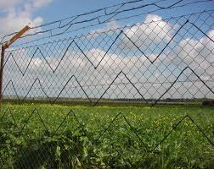
Implementation and Operation of Perimeter Security – Gates and Fences
Barriers are meant to impede or deny access until a security team can respond and may be:
  Natural (i.e. a river)
  Manufactured (i.e. a wall)
Fence construction
  Perimeter Walls and Fences (Heights)
    3 to 4 ft (1 m): Deters casual trespassers
    6 to 7 ft (2 m): Too hard to climb easily
    8 ft (2.4 m) w/ 3 strands barbed wire(top guard): Deters intruders
    Most fencing is largely a psychological deterrent
    Perimeter Intrusion Detection and Assessment System (PIDAS)
Notes:
perimeter intrusion detection and assessment system (PIDAS) A fence system that
has two or three fences used in concert to optimize security. PIDAS fencing is often present
around military locations and prisons. Typically, a PIDAS fence has one tall main fence,
which may be 8 to 20 feet tall. The main fence may be electrified, may have barbed wire/
razor wire elements, and/or can include touch detection technologies. This main fence is then
surrounded by an outside fence, which may only be 4 to 6 feet tall. The purpose of this outer
fence is to keep animals and casual trespassers from accessing the main fence. Sybex 9th ed.
Fence construction: small mesh with large gage best (3/8” by 11g), (2” by 9g is normal) Top guards should be at a 45 degree angle away from the protected area. The fence should be fastened to ridged metal posts set in concrete every 6 feet. Additional bracing at the corners and by gates. The bottom of the fence should be stabilized to prevent climbing under. In soft or sandy soil the fence should be installed below ground level. The use of double fencing with concertina wire positioned between the two fences is the most effective deterrent and cost efficient method.
Perimeter Walls, Fences, and Similar Barriers
Walls and fences provide a clear statement of the physical boundaries of the organization and should act as a deterrent. Considerations:
see all parts of such barriers, using guard patrols, cctv or other means to detect any attempts to break over or through them
ensuring that landscaping and architectural features do not impede line of sight.
ensuring that chain-link fencing is adequately sites in concrete bases and taut. Chain fencing is liable to corrosion and other wear and tear deterioration, checks must be made periodically for signs of weakness in the structure.
combination of barrier types, such as a barbed-wire top guard above the fence or wall
Fences should be designed to steer ingress and egress to controlled points
Fence specifications: smaller gauge = thicker mesh; smaller mesh is harder to climb.
Mesh(in) gauge security
3/8 11 extremely high
1 9 very high
1 11 high
2 6 greater
9 normal
Don’t forget to mention: Tempest; Faraday cages; white noise (random noise in the uniform spectrum); control zones (areas protected by countermeasures)
PIDAS – type of fencing with sensors located on the wire mesh and at the base of the fence. It has a passive cable vibration sensor that sets off an alarm if an intrusion is detected. (Harris, 4th ed.)

Slide 116

Implementation and Operation of Perimeter Security – Gates and Fences
Vehicular Gates
  Class I: residential gate operation
  Class II: commercial (parking lot or garage)
  Class III: industrial or limited access (warehouse, factory, loading dock)
  Class IV: restricted access requiring security personnel (prison, airport)
Notes:
Vehicle and Personnel Entry and Exit Gateways
These gateways include automated barriers. Automated gates and pole barriers that are raised and lowered to allow or prevent vehicular access may need to be manmade or to incorporate some form of surveillance (cctv) to detect instances of tailgating.
3’ to 4’ (1 meter): Deters casual trespassers
6’ to 7’ (2 meters): Too hard to climb easily
8’ with 3 strands of barbed wire (2.4 meters): Deters intruders
Use fences and topography to steer to gate
Vehicular Gates:
Class I – residential gate operation
Class II – commercial (parking lot or garage)
Class III – industrial or limited access (warehouse, factory, loading dock)
Class IV – restricted access requiring security personnel (prison, airport)

Slide 117
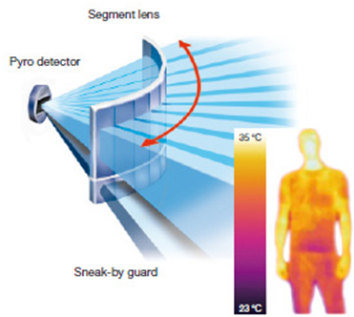
Implementation and Operation of Perimeter Security – Perimeter Intrusion Detection
Infrared Sensors
  Passive Infrared Sensors (PIR or PID)
  Active Infrared Sensors
Microwave
Coaxial Strain-Sensitive Cable
Time Domain Reflectometry (TDR) Systems
Video Content Analysis and Motion Path Analysis
Notes:
Infrared Sensors work by using a specific light sensor to detect a select light wavelength in the InfraRed (IR) spectrum:
Passive Infrared Detector (PID):
Measures light energy within a physical range
When the energy level is changed by the presence of an intruder, the alarm is triggered
Effective in detecting heat and movement but need careful calibration in order to minimize false alarms (heat)
Active Infrared Sensors: transmit an infrared signal via a transmitter
Microwave Systems:
Generate an electromagnetic (RF) field between the transmitter and receiver creating an invisible volumetric detection zone that triggers the alarm when there is a change in the field
Transceivers and control units.
Transceiver units produce and monitor either a measurement of distance (microwave) across the room and trigger an alarm when this changes
Source:
http://www.southwestmicrowave.com/products/microwave-sensors/
Coaxial strain-sensitive cable: coaxial cable is woven into the fabric of the fence. The cable transmits an electric field. The cable moves due to strain on fence fabric caused by climbing or cutting. Changes in the electric field are detected within the cable and an alarm sounds
Time Domain Reflectometry (TDR) systems: send induced RF signals down a cable attached to the fence fabric. Intruders climbing or flexing a fence create a signal path flaw with can be converted into an alarm signal
Video Content Analysis (VCA) and Motion Path Analysis:
Is sophisticated SW analysis of camera images
Applies a complex algorithm to digital Closed Circuit TV (CCTV) camera images which allows the CCTV to detect intruders
Electrical Circuit: uses foil or wire contacts places across door or window frames, carrying a low level of current. (door and windows)
intrusion detection A mechanism of detecting violations of security that specifically
watches for the occurrences of physical or logical access by unauthorized entities to a secured
environment. A specific form of monitoring and analysis of both recorded information and
real-time
events to detect unwanted system access. Sybex 9th ed.

Slide 118

Implementation and Operation of Perimeter Security – Lighting
Types of lighting used for security systems
Continuous lighting (most common)
Standby lighting (automatically or manually turned on)
Movable lighting (movable searchlights or lighting)
Emergency lighting (backup to any of the previous)
Types of lights used in protected areas
Fluorescent (highly efficient and cost effective, temperature sensitive, not good for outdoors)
Mercury vapor (bluish cast, preferred, extended life, take time to warm up)
Sodium vapor (soft yellow, more efficient than mercury, good for fog)
Quartz lamps (produce daylight quality for high visibility)
Fresnel lamps (lighthouses/search lights)
Infrared Illuminators allow night surveillance without using additional lighting
Lumen=1 candle
Footcandle=1 lumen/sqft
Lux=1 lumen/sq meter
Notes:
lighting One of the most commonly used forms of perimeter security control. The primary
purpose of lighting is to discourage casual intruders, trespassers, prowlers, and would-be
thieves who would rather perform their malicious activities in the dark.
NIST standard for lighting 8ft with 2 candle feet of lighting. Sybex 9th ed.
Lighting:
2 candle feet at 8 ft of height (NIST)
Do not illuminate guard positions
Overlap lights
Glare protection
See individuals at 75 feet or more
See facial features at about 33 feet
Lights are detective and deterrent
Lumen: amount of light one candle creates
Footcandle: one lumen per sq ft
LUX: one lumen per sq meter
Fresnel (fray-nell): lights originally used in lighthouses (aimed light)
Rule of thumb: height of pole x 4 = distance between poles
Rule of thumb: wallpack height x 6 = distance between them
Lighting in garages should be 10 to 12 foot-candles over parked cars and 15 to 20 foot-candles in walking/driving areas.
Exterior garage lighting should be placed approximately 12 feet off the ground pointed to the ground. Aim lighting to reduce dark corners where criminals hide.
Code of Federal Regulations lists a specific requirement of 0.2 foot candles (FC) for lighting protected areas within a perimeter. The basic idea for perimeter lighting is .5 FC (equates to 40W bulb in 12x12 room).
Common lighting levels:
Building entrances 5 FC
Walkways 1.5 FC
Parking garages 5 FC
Site landscape 0.5 FC
Areas immediately surrounding the building 1 FC
Roadways 0.5 FC
Lights used for CCTV monitoring 1-2 FC
Infrared illuminators can be used to illuminate a scene for the CCTV systems.

Slide 119
Implementation and Operation of Perimeter Security – Access Control
An Access Control System (ACS) ensures that only authorized personnel are permitted inside a controlled area
Basic components:
  Card reader
  Electric Locks
  Alarms
  Computer systems to monitor and control the ACS
Card Types
  Magnetic stripe
  Proximity card
  Smart cards
Access Control Head End
  Is the application SW housed in the CPU and provides the intelligent controller where all ACS activity is monitored, recorded, commanded, and controlled by the operator
Notes:
Access Control Head End:
The CPU retains the system-specific programming to allow entry (access) for authorized personnel and deny access to unauthorized personnel

Slide 120
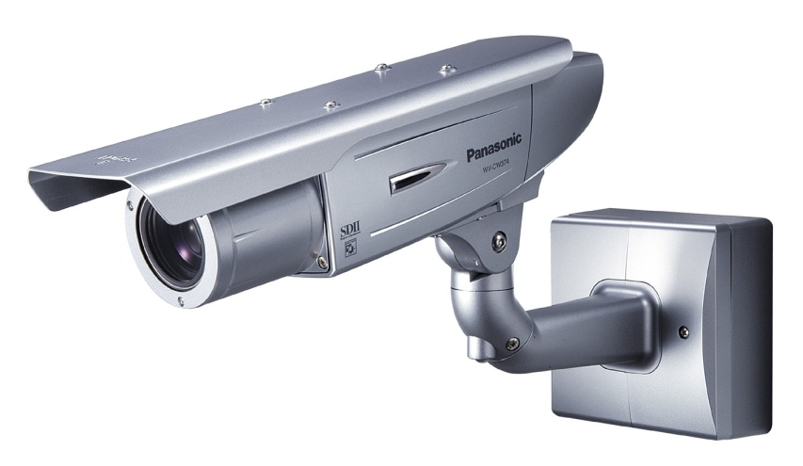
Implementation and Operation of Perimeter Security – Closed-Circuit Television (CCTV)
Is a collection of cameras, recorders, switches, keyboards, and monitors that allow viewing and recording of security events
Is integrated into the overall security program
Security functions:
  Surveillance
  Assessment
  Deterrence
  Evidentiary Archives
Notes:
closed-circuit
television (CCTV) A security camera system that resides inside an organization’s
facility and is usually connected to monitors for the security guards to view as well
as to a recording device. Typically deployed with its own isolated cabling rather than being
integrated into the IP network (as is the case with IP, web, or typical security cameras). Sybex 9th ed.
Surveillance
Gives the viewer the capability to be made aware of or view visual events at multiple locations from a centralized remote viewing area
Assessment
Alarm events can be assessed and allow the security professional to make a determination as to what type of response may or may not be required
Deterrence
May deter burglary, vandalism, or intrusion due to fear of discovery and prosecution
Evidentiary Archives
Archived images may be helpful in the identification and prosecution of trespassers, vandals and other intruders

Slide 121
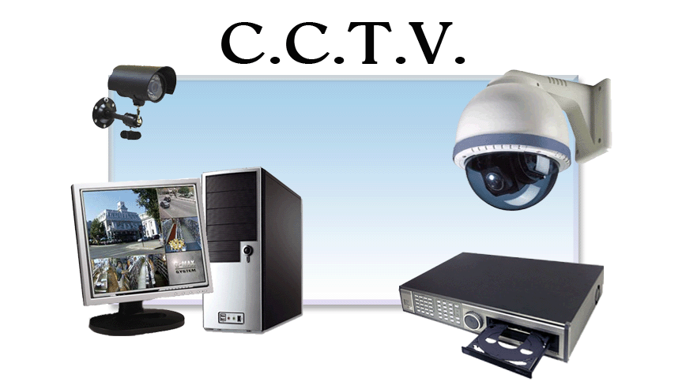
Closed-Circuit Television (CCTV) – Cameras
Fixed position cameras
Pan Tilt Zoom (PTZ)
Ability to be recorded (DVR or NVR)
  DVR uses internal storage where a NVR uses TCP/IP and network storage
CCTV displays
  Fixed
  Autoscan
  Multiplex
Alarm monitoring (i.e. human intervention)
Notes:
Positioning of cameras at an adequate height to avoid physical attack
Appropriately distributed to exclude any blind areas between each camera range
Adequate lighting in all condition. Black and white cameras are more sensitive for night viewing. Color cameras require more light. Color works down to 1.5 foot-candles of light. Standard black and white can work down to .5 foot-candles.
Appropriate lenses (fixed or zoom) and ability to PTZ. Always use auto iris for outdoor cameras. Always set the focus in low light with auto-iris cameras. Special dark focus filters (neutral density) reduce lighting by one or more stops of exposure.
Point cameras away from the sun and capture as little sky in frame as it messes with contrast. Best is to mount camera high and point down.
Ability to be recorded
Having the camera system tied into the alarm system (having cameras automatically point to area affected by alarm)
Regular servicing of moving parts, and ensuring that lenses remain clean
Human intervention (monitoring / watching the video)
Color cameras offer more information
Dome cameras are cheaper versions of PTZ cameras as the installation is usually easier.
IP cameras capture images digitally. Data is transmitted via the LAN to a video server. IP cameras are the least secure CCTV system.
Detective Control
SURVEILLANCE versus IDENTIFICATION
Surveillance: cheap but little evidence value
Identification: expensive and higher evidence value

Slide 122
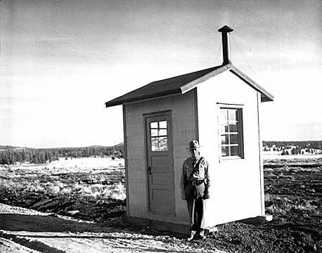
Implementation and Operation of Perimeter Security – Guards
Guard post
  Gate control
  Shift overlap
  Glare protection
Checking and escorting visitors on Site
  Defend against unauthorized access
Managing deliveries to the Site
  Different levels of security
    Reception areas, CCTV, management of entry and exit points
Notes:
Guard post: may include vehicle gates control, patrols of perimeters, staff and visitor car parks, buildings, vehicle inspections, and monitoring of CCTV.
Checking and escorting visitors on Site: Ability to identify and account for visitors on site. Hackers have used social engineering to enter sites.
The design and configuration of work areas and visitor areas should be carefully considered. There should not be equal access to all locations within a facility.
Valuable and confidential assets should be located in t he heart or center of the building
Managing deliveries to the Site: individual buildings on the site may need differing levels of security.
GUARDS are a dynamic control as they are dual functioned. They can protect and perform duties. They are usually attacked via social engineering
Protect guard and check points by employing glare control (lighting).
Guards are also known as security officers
DOGS are good for guarding rigid turf. They are both a deterrent and detective means. They do present a legal liability. Most professionally trained guard dogs only corner an intruder but will attack if the intruder flees.
Source: Edited by Tipton, Harold F. and Kevin Henry. Official (ISC)2 guide to the CISSP® CBK ® Boca Raton: Auerbach Publications, 2007 Hansford, Paul, Domain 4 Physical (Environmental) Security Hansford, Paul, Domain 4 Physical (Environmental) Security pages 288 - 290

Slide 123

Implementation and Operation of Perimeter Security – Dogs
Good perimeter defense in a controlled area
Deterrent and detective measure
Dogs present a legal liability
  Most trained dogs will not attack if the suspect is stationary
  Most victims of dog attacks do not know this

Slide 124
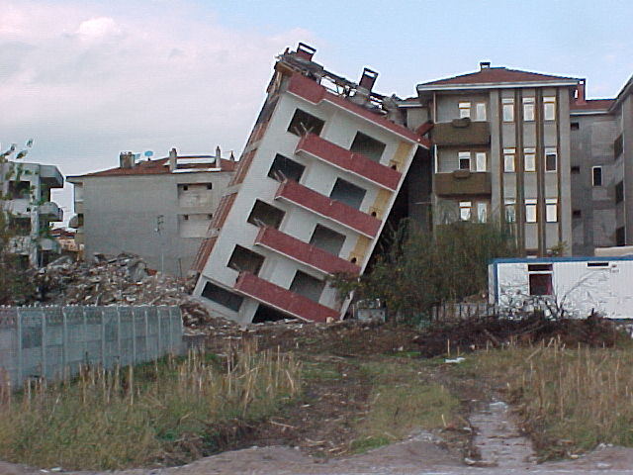
Shared Tenancy, Adjacent Buildings, and Shared Demarc
Shared Tenancy and Adjacent Buildings
  Difficult for territorial reinforcement
  Lax security in one company or building can impact others
  Wireless systems may be causing interference or provide a location for monitoring
Shared demarcs require Strong physical access control
Notes:
Demarc:
The place where the Internet Service Provider responsibility ends and the customer’s begins is called the demarcation point
Access to the demarc point can jeopardize confidentiality, integrity, and availability
Segregated demarcs is advisable for higher security areas

Slide 125

Access Control – Internal Security
Interior Intrusion Detection Systems provide an additional layer of protection within the facility
  Balanced Magnetic Switch (BMS)
  Motion Activated Cameras
  Acoustic Sensors
  Infrared Linear Light Beam Sensors
  Passive Infrared (PIR or PID) Sensors
    Dual-Technology Sensors
Notes:
Balanced Magnetic Switch operates similar to electric circuit but uses magnets or a mechanical contact to determine if an alarm signal is initiated
Motion Action Cameras:
Uses a fixed camera with a video motion feature
It can be activated upon motion (i.e. a door being opened) and can give a control center operator a detailed video of actual events during alarm activation
Acoustical detection system:
Uses passive listening devices (i.e. microphones on floors, walls, ceilings) to monitor building spaces
Is usually tied into a password-protected building entry control system
Will trigger an alarm if sound is detected
May pick up false noises (i.e. HVAC system)
Infrared Linear Beam Sensors:
A focused IR light beam is projected from an emitter and bounced off of a reflector that is placed on the other side of the detection area
Alarm triggers when the beam is broken
Used in garage door sensors
Passive Infrared Detector (PID):
One of the most common volumetric intrusion detection sensors
Picks up heat signatures
Works best in a stable, environmentally controlled space
Often used in an automatic request to exit (REX) device for magnetically locked doors
Uses an alarm reduction technology:
Dual-Technology Sensors uses a combination of PIR and microwave
Alarm triggered when both sensors detect an intruder
Other intrusion detection technology:
Electrical Circuit: uses foil or wire contacts places across door or window frames, carrying a low level of current. (door and windows)
Light Beam: photoelectric cell receives a small light source across the secure boundary. When the path of light to the cell is interrupted, the alarm is triggered. (gate and door way) dust and small material may trigger alarm.
Sounds and Vibration
Vibration sensors: detect vibration
Secondary verification: trip two sensors before alarm sounds; prevents false alarms
Wave pattern: like sonar; low ultrasonic; high microwave; looks for pattern
Capacitance: electric field; charge around an object or its magnetic field

Slide 126

Access Control – Escort and Visitor Control
Beware of attempts to reuse old badges, stolen badges, fabricated badges or social engineering
Mitigation methods:
  Time based badges
  Color coded badges for different days of the week
  Electronic badges
  Provide guards to escort visitors

Slide 127
Access Control – Port Controls
Portable devices can be used to move large amounts of data both legally and illegally
Methods to control their use:
  Physically disable port
    Disconnect
    Physically block access to it
  Electronically lock the port
    Disable in software

Slide 128
Access Control – Building and Inside Security
Doors (includes the door, its frame and anchorage to the building)
  Should fit snuggly in the frame
  Doorframes and locks must be as secure as the door
  Perimeter doors
    Consist of hollow steel doors or steel-clad doors with steel frames
  Exterior doors
    Should open outward if in an inhabited area
    Hinges should be located on the interior of restricted areas
  Glass doors
    Material should be of a laminate material or stronger
  Sensitive areas should have an automatic door closing device
Notes:
Door Design and Materials:
If glass, need to ensure that people on the outside of a room cannot see the computer screen; If hollow, not much security as the door can be cut through; If solid, door is more secure. DOOR AND
WINDOW ARE WEAKEST LINK IN WALL
Fail-secure: locks
Fail-safe: unlocks
Fail-soft: operates at a reduced capacity. Ex: An automatically opening sliding door that will open, but not automatically; has to be pushed open.
Window Glass and Types:
Windows –(Page 295 ISC2)
Standard: plate glass is relatively brittle,
Tempered glass costs more but breaks into small pieces (is made by rapidly cooling glass that has been heated in a furnace.
Shatter-proof security film can help to prevent people seeing through a window and from injury due to a broken window
Windows can be laminated with wire mesh or polycarbonate between layers
Lexan be used as well, but it can burn (use in aircraft windows)
Slab and raised floors -150lbs/sqft
Raised floors – nonconductive and grounded
Doors swing out to facilitate escape (hinge on outside). Hinges must be secured against intruders
Internal door hinges should be inward facing and protected
Externally facing emergency doors should be marked for emergency use only, have a panic bar, and be connected to an alarm
Bullet Resistant standard is 1 ¼ inch thick (stops a 9mm round)
Glass Break Sensors: good intrusion detection device for buildings that have a lot of windows. They can be acoustic that listen for the frequency of breaking glass or shock sensors that feel the shock wave when glass is broken. Using both technologies is best as this defeats false alarms.

Slide 129
Building and Inside Security – Door Locks
Electric Locks
  Is a secure method to control a door
  An electronic lock actuates the door bolt
Electric Strikes
    The door and bolt remain stationary and the strike is retracted
Magnetic Locks
  Power is applied to the magnets to hold the door closed
  Per the U.S. Life Safety Codes
    Magnetic locks require an emergency manual override button
      When someone approaches the door in the exit direction
Anti-Passlock
  Used in high security areas and users must badge in and out
Notes:
Electric Locks:
Power is applied to engage the handle which allows the user to retract the bolt
May consist of:
Built-in position switches
Request-to-exit HW
A special hinge is required
Expensive
Usually require a new door
Electric Strikes:
Fail-safe configuration allows the door to be opened from the public side
Fali-secure configuration requires a manual key entry to unlock the door from the public side
Unimpeded access is allowed for in the direction of exit by:
Activating a door handle or lever from the secure side
Easily retrofits to existing doors
Magnetic Locks:
Is surface-mounted to the door and doorframe
Easily retrofits to existing doors
Are usually fail-safe
Anti-Passlock:
Uses a card reader & badge
Provides personnel accountability
Prevents users from giving their badge or PIN to someone else
Improperly badging out will prevent deny into the restricted area

Slide 130

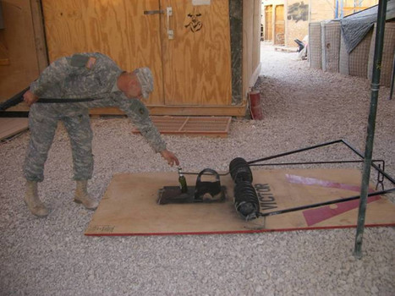
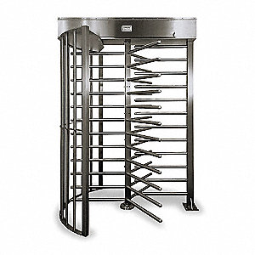
Building and Inside Security – Turnstiles and
Mantraps
Mantrap
  Entry with two doors
    First door must close and log prior to the second door opening
    Each door must require a different form of authentication to open
Turnstile
  Designed to prevent tailgating
  Allow only one person at a time to access
Vehicle and Personnel Entries and Exits
  Bollards (small concrete pillars)
Both must allow safe egress in case of an emergency
No system should require authentication in order to exit during an emergency
Notes:
mantrap This term is deprecated. See access control vestibule. Sometimes man-trap
or man trap.
turnstile A form of gate that prevents more than one person at a time from gaining entry
and often restricts movement in one direction.
access control vestibule A double set of doors that is often protected by a guard. The
purpose is to contain a subject until their identity and authentication are verified. Previously
known as a mantrap.
Sybex 9th ed.

Slide 131

Building and Inside Security – Tailgating and Piggybacking
Bypass an access control method by following an authorized person through the entry point
Policies should include language prohibiting employees for allowing the practice
Beware the social engineer
Notes:
tailgating A means by which an unauthorized person gains access or entry to a secured
environment using the credentials of an authorized person who is unaware that the tailgater
is present. See also piggybacking.
piggybacking The act of convincing someone to allow an unauthorized entity through
a secured gate or doorway without being identified, or authorizing them directly. See also
tailgating.
Sybex 9th ed.

Slide 132
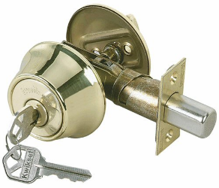
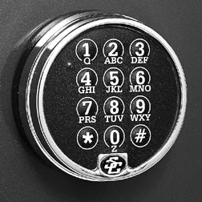
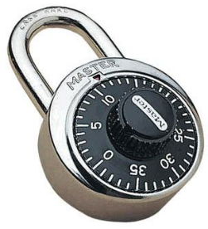
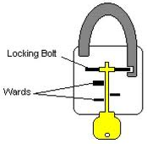

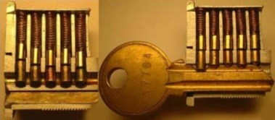
Building and Inside Security – Keys, Locks and Safes
Key locks are a basic safeguard in protecting buildings, personnel and property (i.e. doors and windows)
  Types:
    Rim Lock
    Mortise Lock
    Locking Cylinders
    Cipher Locks
    Hi-Tech Keys
      Intelligent Keys
      Instant Keys
Notes:
Rim Lock:
Associated with dead bolt locks
Is a lock or latch mounted on the surface of a door
Mortise Lock:
Is a handle and locking device all in one package
Is a lock or latch that is recessed into the edge of a door rather than being mounted to its surface
Locking Cylinder:
Is a locking cylinder that is composed of circular pin tumblers that fit into matching circular holes on two internal parts of the lock
The pin tumbler functions on the principle that the pin tumblers need to be placed in a position that is entirely contained within the plug
Cipher Locks:
Is controlled by a mechanical key pad (5-10 digits long)
Requires the right combination to gain access
Hi-Tech Keys:
Intelligent Keys
Have a built in microprocessor which is unique to the key holder
The lock contains a microcomputer and the key exchange data allows the lock to make valid access decisions for the key holder
Instant Keys
Provides a quick way to disable a key by permitting one turn of the master key to change a lock
ALSO Mention: cable locks, port controls, switch controls, peripheral switch controls
Other locking systems, using keys and other devices, remain among the most common form of access control to premises:
Key and Deadbolt Locks: (preventive)
Keys locks require a physical key to open the lock
Deadbolt locks additionally comprise a bolt or bolts that are thrown from the door into the door frame when the key is turned, providing additional strength against a physical attack.
Combination and keypad locks tend to be written down or seen by others
Combination Locks: combination locks comprise a numbered tumbler or dial that must be turned clockwise and anticlockwise a number of times to preset numbers to open the device. Typical master lock has 64,000 combinations. Can be brute forced
Electric locks actuate the door bolt. They are expensive. Electric strikes differ from an electric lock . Electric locks move a bolt where as a strike is moved instead of the bolt when using electric strikes. Electric strikes can be set up to fail save(open from public side) or fail secure (locked on public side). Both types usually require purchasing a new or special door.
Magnetic locks are popular as they work with existing doors. Power is applied to magnets to keep the door closed. They normally are set to fail safe. They require an emergency manual override button and an automatic sensor (weakens security)
Keypad or Pushbutton Locks: keypad and pushbutton locks require a combination of numbers to be learned and secured. 5 button pad has 1081 combinations. Can be brute forced.
Smart Locks: can be programmed to limit access during work hours only for example. Tied to a central database. Can use anti-passback where a record is kept who entered and who left and to not allow the reuse of a credential for exit until it has exited.
Warded- set of obstructions that block or prevent the lock from opening unless the correct key is used (skeleton key)
Tumbler- pin, wafer, lever tumblers with smooth, embossed, or uneven surfaces
SECURITY ISSUE: master key and core key can open any door (core key used to change lock care
Digital Locks - any effective technology, device or component that:
Controls access (access control)
Restricts exercising the exclusive rights of a copyright owner (copy control)

Slide 133
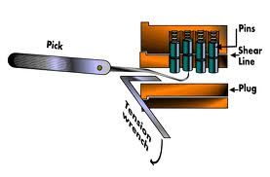
Keys, Locks and Safes – Lock Picking
Lock Picks
  Tools used to depress the pin tumblers
Key bumping
  Shaved down key that allows the lock to be bumped thus allowing the lock to be turned
Master key
  Opens all locks of a certain type or series
Core key
  Used to change out the keying portion of the lock
Shimming
  Using a thin material to circumvent the lock catch
Notes:
bumping A type of lock picking or lock bypass method that uses a modified key that is
tapped into a lock. Sybex 9th ed.

Slide 134
Keys, Locks and Safes - Key Control
Lack of key control is one of the biggest security risks faced by business or property owners
Must know who has keys
Must protect against unauthorized duplication
Should appoint a key control manager
Develop a policy and method for issuing and collecting keys
All keys should remain the property of the issuing facility
Only issue for official use by authorized individuals
Employees must ensure keys are safeguarded and properly used
Notes:
Patent controlled key systems have lock cylinders that employ very precise locking systems that can only be operated with unique keys. Cylinders and keys are patented and can only be used by factory authorized professional locksmiths.

Slide 135
Functional Security Operations Concepts – Key Themes
Maintain Operational Resilience
  Maintaining the expected levels of service availability and integrity
Protecting Valuable Assets
  Protect sensitive of critical resources from compromise
Controlling System Accounts
  Provide checks and balances against privileged accounts
Managing Security Services Effectively
  Reporting and continuous service improvement practices

Slide 136
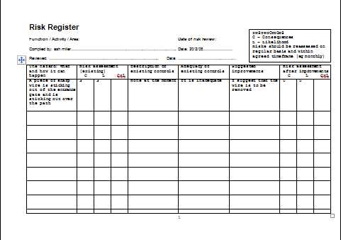
Building and Inside Security – Asset Tracking
Enhances physical security
Useful tool to analyze loss, theft, or disasters
Supports regulatory compliance by pinpointing data location
Tracks the relationship between customers and employees to the data and various devices that they use
Asset and Risk Registers
  List of assets
  List of staff who access secure areas
    Useful to establish possible personnel with opportunity to commit the theft
Notes:
Track all physical and logical assets- software makes it easier
Controls:
A digital asset manager is a growing enterprise role
Track/authenticate with rfid
Disposal of assets needs to be considered – proper destruction and archival in accordance with policy/governance etc.
-Skillport cissp2018
A risk register is a tool commonly used in project planning and organizational risk assessments. It is often referred to as a Risk Log (for eg in PRINCE2)
Can help audit against theft and acquisition, movement, and decommission of system and security equipment.
Important as wireless technology allows systems infrastructures to become more dynamic and mobile.
Records can be made of those members of staff who hold combination and PIN number o access secure zones. Ability to ensure physical ACL is up to date when staff leaves organization.
Registers covering physical sources and types of threats and vulnerabilities can be used in reviewing and auditing the effectiveness of physical, environmental and procedural security against changes in the risk , practices and physical infrastructure of the organization
Source: Edited by Tipton, Harold F. and Kevin Henry. Official (ISC)2 guide to the CISSP® CBK ® Boca Raton: Auerbach Publications, 2007 Hansford, Paul, Domain 4 Physical (Environmental) Security pages 293 – 300
Source: http://en.wikipedia.org/wiki/Risk_register

Slide 137
Information Lifecycle
Information Lifecycle (many different versions exist)
Information Lifecycle as defined by ISO 27002
Creation or Capture
Classification
Storage
Usage
Archive
Destruction or purging
Creation and origination
Processing
Storage
Transmission
Deletion and destruction
Notes:
information lifecycle The series of changes of data through its existence. A typical
information lifecycle starts at creation or capture and then moves into classification,
then secure storage, then protected use, then archiving, then destruction or purging.
Aka information life cycle. Sybex 9th ed.

Slide 138
Resource Protection
Tangible assets
  Physical in nature
    Traditional property
Intangible assets
  Not physical in nature
    Intellectual property

Slide 139
Domain Objectives 7.15
7.15 Address personnel safety and security concerns
  Travel
  Security training and awareness
  Emergency management
  Duress

Slide 140
Personnel Safety
Personnel are a great asset when designing physical and environmental security
Mobile computing has raised issues about privacy and physical concerns when traveling
  Privacy
    Difference in perspective as to what falls under ‘the right to privacy’
    Privacy policy should address monitoring
  Traveling
    Ensuring the safety of personnel and corporate data while traveling
Notes:
No expectation of privacy in many parts of the world
Electronic transmissions can be intercepted
Security services and criminals will track your movements using your mobile phone
Security services and criminals will insert malware into your device through connections they control
Malware can be transferred to your device via various media of “gifts”
Transmitting sensitive government, personal, or proprietary info from abroad is risky
Corporate/government officials are at risk
Beware of phishing scams
Unattended devices that are examined by “officials” are often copied

Slide 141
Personnel Safety – Traveling
Before you travel
  If you do not need the electronic device, don’t take it
  Do not travel with information you do not need
Prepare your device
  Create strong passwords
  Change passwords as soon as you return
While you’re away
  Avoid placing devices in checked baggage
  Use digital signatures and encryption
When you return
  Change passwords
  Examine the device for malware
Notes:
Before you travel:
Backup all information you travel with; leave the backup at home
Seek official cybersecurity alerts from trusted sources
Prepare your device:
Download current and up-to-date anti-virus and other protection software
Encrypt all sensitive information (encryption may be illegal in some countries)
Update web browser with strict security settings
Disable infrared ports
Use a virtual machine to run your desktop
While you’re away:
Remove batteries and SIM cards
Do not use thumb drives given to you
Shield passwords from view
Be aware of shoulder surfing
Terminate connections not in use
Clear browser cache after use
Do not open email attachments from unknown sources
Avoid Wi-Fi networks
Report stolen devices immediately to your home organization and local U.S. Embassy or consulate
When you return:
Refer to general travel alerts for tips or warnings

Slide 142
Personnel Safety – Duress
Divulging something you normally wouldn’t but did under threat of harm
Proper training is crucial to ensure personnel safety as situations can occur quickly
Personnel with access to an asset are targets of duress
The protection and risk of duress follows the asset and the access to the asset
Notes:
duress system A button or code that sends a distress call. A monitoring entity receives the
distress call and responds based on established procedures. Duress systems are useful when
personnel are working alone. Sybex 9th ed.

Slide 143

Questions?

