Slide 1
ZOOM
https://www.zoom.us

Slide 2
About Zoom
Zoom is the leader in modern enterprise video communications, with an easy, reliable cloud platform for video and audio conferencing, chat, and webinars across mobile, desktop, and room systems.
Zoom Rooms is the original software-based conference room solution used around the world in board, conference, huddle, and training rooms, as well as executive offices and classrooms.
Founded in 2011, Zoom helps businesses and organizations bring their teams together in a frictionless environment to get more done.
Zoom is a private company headquartered in San Jose, CA.

Slide 3
Basic
Personal Meeting
Free
Host up to 100 participants
Unlimited 1 to 1 meetings
40 mins limit on group meetings
Unlimited number of meetings
Online support
Many free Video Conferencing, Web Conferencing Features, and Group Collaboration Features
Encryption

Slide 4
Pro
Great for Small Teams
$14.99/mo/host
All Basic features +
Includes 100 participants
Unlimited meeting duration for all meeting sizes
User management
Admin feature controls
Reporting
Custom Personal Meeting ID
Assign scheduler
1GB of MP4 or M4A cloud recording
Skype for Business (Lync) interoperability
Optional Add-on Plans

Slide 5
Business
Small & Med Businesses
$19.99/mo/host
*Minimum of 10 hosts
All Pro features +
Includes 100 participants
Dedicated phone support
Admin dashboard
Vanity URL
Option for on-premise deployment
Managed domains
Single sign-on
Company branding
Custom emails
LTI integration

Slide 6
Enterprise
Large Enterprise-Ready
$19.99/mo/host
*Minimum of 100 hosts
All Business features +
Includes 200 participants
Unlimited Cloud Storage
Dedicated Customer Success Manager
Executive Business Reviews
Bundle discounts on Webinars and Zoom Rooms

Slide 7
Zoom Software
Download Zoom Mobile Apps for iPhone https://itunes.apple.com/us/app/id546505307 or Android https://play.google.com/store/apps/details?id=us.zoom.videomeetings
Download Zoom Client for Meetings https://zoom.us/client/latest/ZoomInstaller.exe

Slide 8
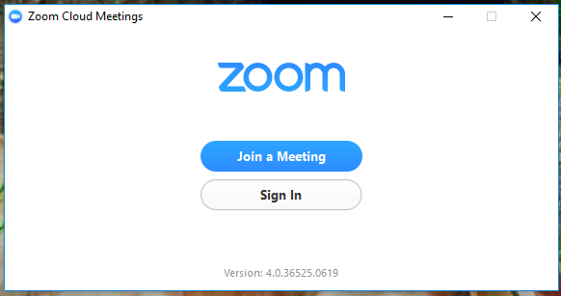
First Screen

Slide 9
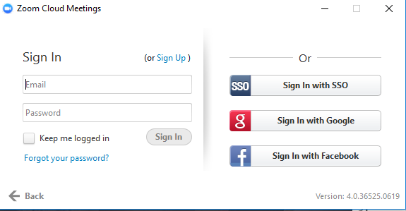
Sign In Screen

Slide 10
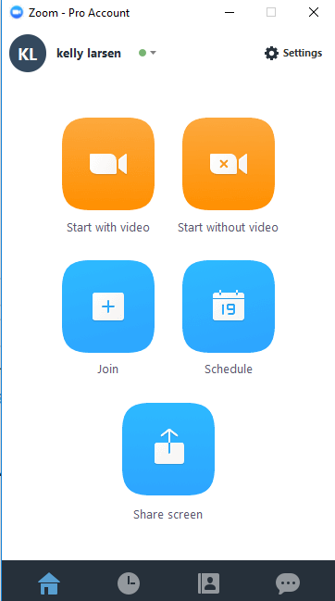
First Screen After Signing In

Slide 11
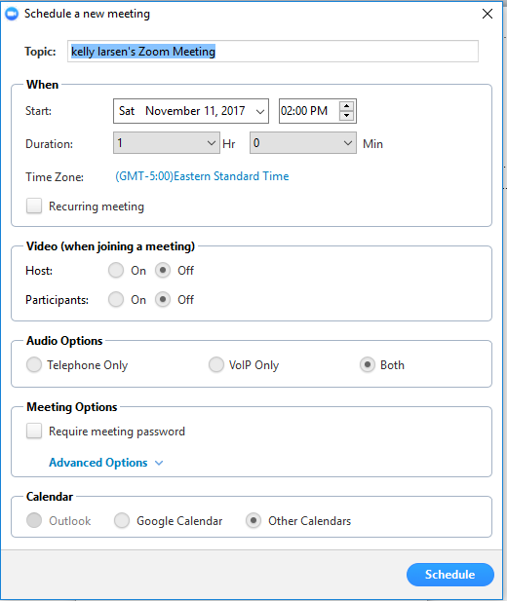
Schedule a Meeting

Slide 12
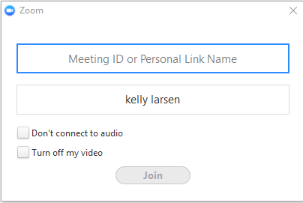
Join a Meeting

Slide 13
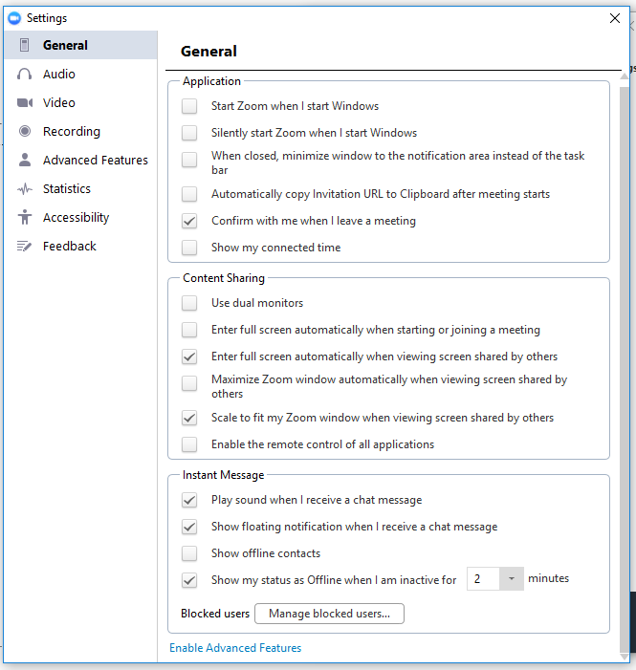
General Settings

Slide 14
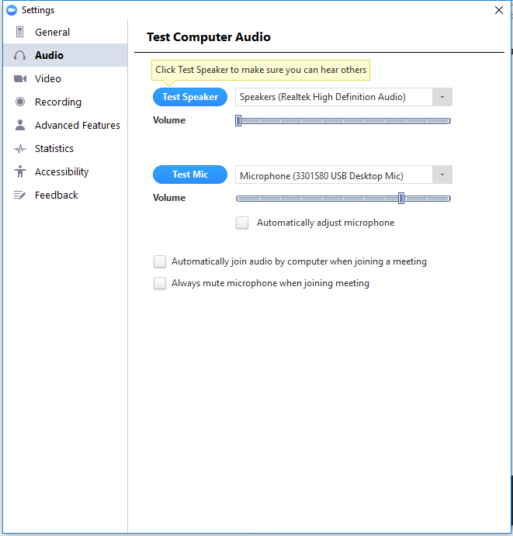
Audio Settings

Slide 15
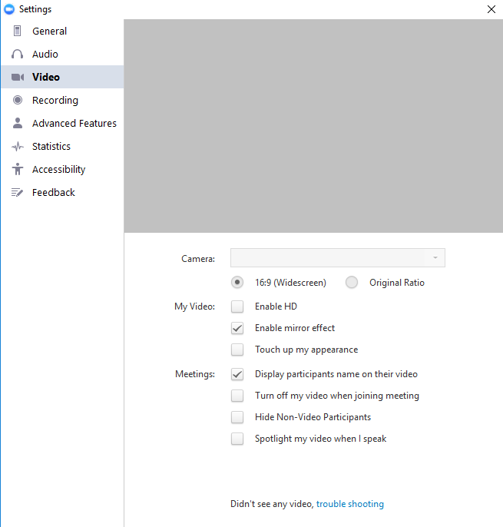
Video Settings

Slide 16
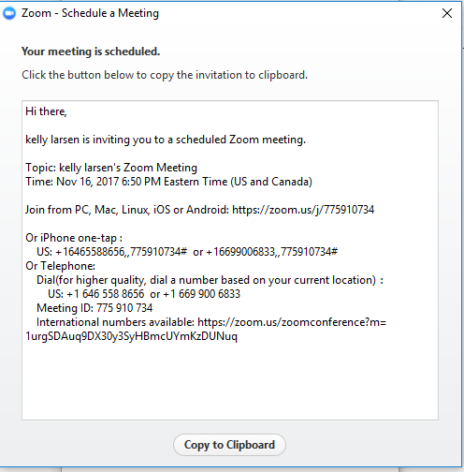
Message To Attendees

Slide 17
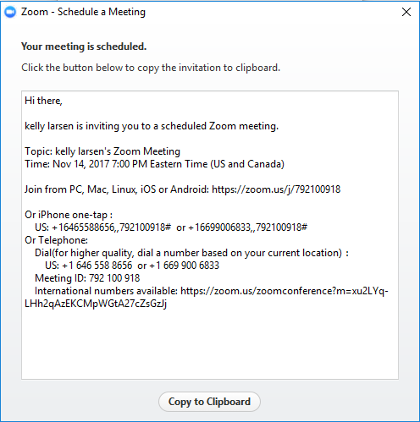
Join this meeting

Slide 18
QUESTIONS?

